Slide 1
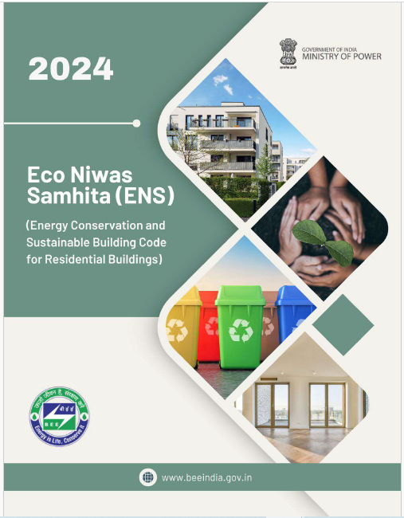
ENS 2024
Energy Management and Conservation
Prepared by : LCES
Created Jan 2025
Notes:
Time- 45 Sec
The Eco Niwas Samhita is a set of guidelines focused on sustainable residential building practices in India.
The code got amended in 2024 with sustainable practices and it is also called ECSBC for residential buildings .

Slide 2
Energy Management and Conservation
Objective
Provide guidelines for energy conservation in buildings after occupancy, using passive and active strategies, and integrating renewable energy. It covers key areas such as building envelope, services, electrical usage, and renewable systems.
Image source: Freepik, Link
Notes:
Time: 45 seconds
Self explanatory – Presenter can straightaway give a brief insight by just reading out the objective since it is already crisp.

Slide 3
Building Envelope
Indoor Electrical Use
Openable Window-to-floor Area Ratio
Visible Light Transmittance
Thermal Transmittance Of Roof (Uroof)
Residential Envelope Transmittance Value (RETV)
Transmittance Of Building Envelope
Indoor Lighting
Comfort System
SCOPE
BUILDING SERVICES
RENEWABLE ENERGY SYSTEMS
Power Factor Correction
Energy Monitoring
Electric Vehicle Charging System
Electric Systems
Common Area And Exterior Lighting (If Applicable)
Elevators (If Applicable)
Pumps (If Applicable)
Solar Water Heating
Solar Photovoltaic

Slide 4
Mandatory Provisions
Building Envelope
Building Services
Indoor End Electrical Uses (If applicable)
Renewable Energy Systems
Openable Window-to-floor Area Ratio
Power Factor Correction
Indoor Lighting
Solar Water Heating
Energy Monitoring
Visible Light Transmittance
Electric Vehicle Charging Systems
Comfort Systems
Solar Photovoltaic
Thermal Transmittance Of Roof (U_{roof})
Pumps
Residential Envelope Transmittance Value (RETV)
Common Area & Exterior Lighting
Mandatory and Incremental provisions
Elevators
Transmittance of Building Envelope
Mandatory provisions
Electrical Systems
Notes:
Time: approx. if presenter wants to brief only about the main modules leaving behind the submodules, then it may take around 30 seconds.
Self explanatory

Slide 5
Mandatory REQUIREMENTS
Prescriptive requirements
(Meet the specified minimum energy performance standards of each of the applicable component)
Points system
(Achieve minimum points (120 Pts) required
as per building typology)
Category | Maximum incremental points | ENS + | Super ENS
Building Envelope | 40 | 12 | 20
Building Services | 28 | 8 | 14
Indoor electrical Use | 42 | 13 | 21
Renewable energy systems | 10 | 3 | 5
 | Total | 36 | 60
Notes:
Time: 30 seconds
Self explanatory, presenter can just go through what’s there on slide.

Slide 6
Mandatory Requirement
5.2.1 - Building ENVELOPE
Roof
Roof
Walls
Windows/Doors
Walls
Windows/Doors
Building Envelope
The building envelope is the physical barrier between the exterior and interior environments enclosing a structure
Notes:
Time: 20 seconds
The building envelope acts as a barrier between indoor and outdoor environments. It includes roofs, walls, and windows, and its performance significantly affects energy use.

Slide 7
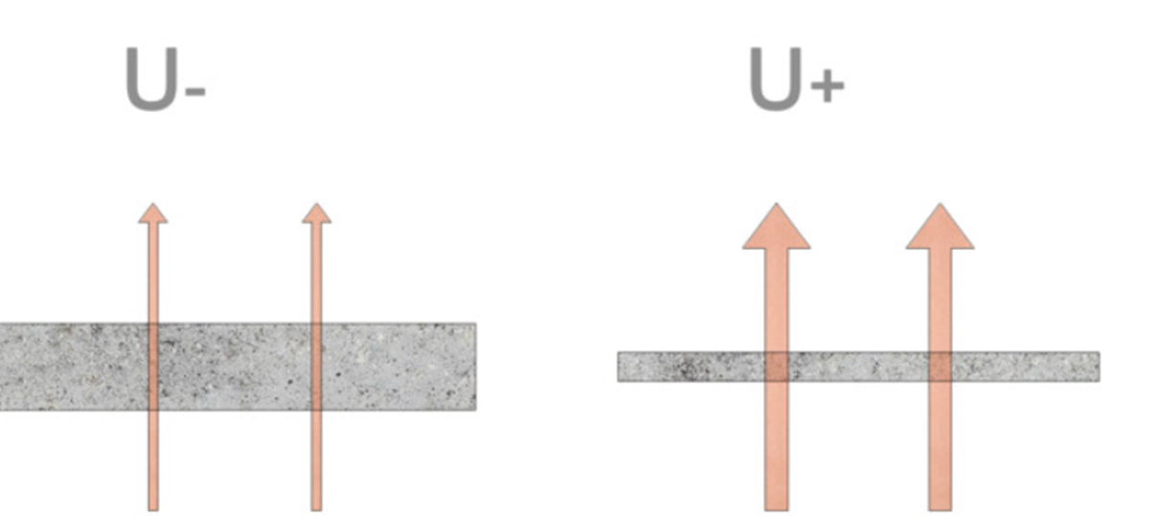
Quick Glance: Understand U-Value, SHGC, and VLT
U-Value (Thermal Transmittance) measures how well a window resists heat transfer (both conduction and convection). Lower U-value means better insulation, reducing heat loss.
SHGC (Solar Heat Gain Coefficient) indicates how much solar radiation (heat) is allowed to pass through the window. Lower SHGC reduces the amount of heat entering, keeping interiors cooler.
VLT (Visible Light Transmittance) shows how much visible light can pass through the window. Higher VLT means more natural light enters, while lower VLT indicates darker glass, reducing glare but also light.
Incident
Sunlight
Reflected
Transmitted
A lower U-value indicates better insulation
Notes:
Time: 1 min
U-Value: Measures heat transfer. Lower U-values mean better insulation, reducing heat loss or gain.
SHGC: Indicates the amount of solar heat entering through windows. Lower SHGC values help maintain cooler interiors.
VLT: Determines how much visible light passes through a window. Higher VLT reduces artificial lighting needs while ensuring sufficient daylight.

Slide 8
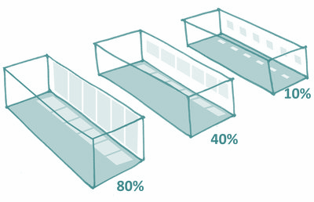
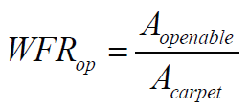
Mandatory Requirement
5.2.1.1- Openable Window to Floor Area Ratio
Window to floor area ratio is the ratio of openable area to the carpet area of the dwelling units.
Individual building blocks, shall comply with the values given in Table 8
Image source: Freepik, Link
Table – 8: Minimum requirement of window-to-floor area ratio
Climatic zone | Minimum WFRop (%)
Composite | 12.50
Hot-Dry | 10.00
Warm-Humid | 16.66
Temperate | 12.50
Cold | 8.33
Source: NBC 2016, Link
Notes:
Time: 30 seconds
Window-to-floor area ratio is the proportion of openable window area to the carpet area of a dwelling. This ratio ensures proper ventilation and daylighting. For this, table 8 in the National Building Code for minimum requirements should be referred.

Slide 9
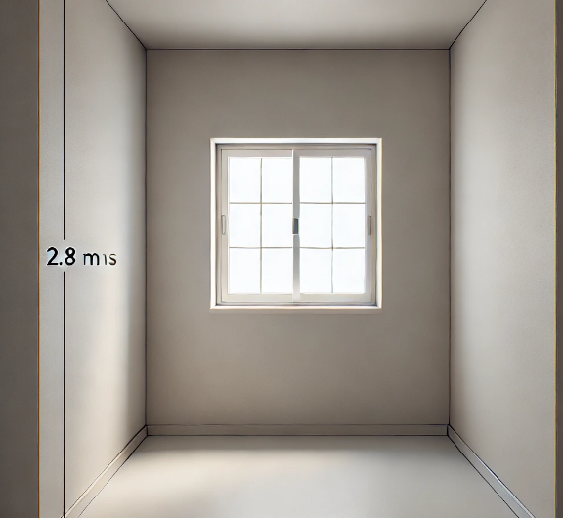
Mandatory Requirement
5.2.1.2- Visible Light Transmittance
Table – 9: Minimum visible light transmittance requirement
WWR is the ratio of the area of non-opaque building envelope components of dwelling units to the envelope area (excluding roof) of dwelling units.
The glass used in non-opaque building envelope components (transparent/translucent panels in windows, doors, etc.) shall comply with the requirements given in Table 9
Window-to-wall ratio (WWR) | Minimum VLT
0–0.30 | 0.27
0.31–0.40 | 0.20
0.41–0.50 | 0.16
0.51–0.60 | 0.13
0.61–0.70 | 0.11
Sample Calculation:
Room Dimensions: 4 m (width) × 2.8 m (height)
Wall Area:2.8 𝑚×4 𝑚=11.2 𝑚2
Window Dimensions: 1.2 m × 1.5 m
Window Area:1.2 𝑚×1.5 𝑚=1.8 𝑚2
WWR = Window Area/Wall Area=1.8 𝑚2/11.2 𝑚2≈0.16.
Minimum VLT required is 0.27
4mts
Source: NBC 2016, Link
Notes:
Time: 50 seconds
As discussed, VLT is a factor that determines how much visible light passes through a window. For this provision compliance one should meet the requirement mentioned in the table 9. For better understanding, here’s a simple calculation considering a room with dimensions 4x2.8m, continue explaining the calculation referring to the slide.

Slide 10
Mandatory Requirement
5.2.1.3- Thermal Transmittance of Roof (URoof)
Table – 14: Points for Thermal Transmittance of Roof
Uroof (W/m²·K) | Formula for Points Calculation | Incremental Points
0.28 ≤ U_{roof}< 1.2 | (1.2 - U_{roof}) / 0.23 | Up to 4
U_{roof} < 0.28 | - | 4
Thermal transmittance of roof shall comply with the maximum value of 1.2 W/m²K.
Sample Calculation:
Outside to inside | Thickness(M) | Specific heat (kj/kg.k) | Density (kg/m3) | Conductance (w/m.k) | R-Value (w/m2.k) | (U-value (w/m2.k)
Plaster | 0.018 | 0.84 | 1762 | 0.7210 | 0.02 | 1.00
RCC Roof | 0.15 | 0.88 | 2288.00 | 1.58 | 0.09
Plaster | 0.01 | 0.84 | 1762 | 0.7210 | 0.01
25mm EPS insulation | 0.025 | 1.34 | 16.00 | 0.04 | 0.66
Rse |  |  |  |  | 0.04
Rsi |  |  |  |  | 0.17
Assembly Total |  |  |  |  | 1.00
A_{roof} : total area of the roof (m2 )
U_{i} : thermal transmittance values of different roof constructions (W/m2 .K) A_{i} : areas of different roof constructions (m2 )
Notes:
Time: 75 seconds
Thermal transmittance, or U-Roof, measures a roof's ability to resist heat transfer. The maximum allowable value is 1.2 W/m²K. Continue with the formula mentioned over the slide (*explanation should include the abbreviations i.e. Thermal transmittance of the roof can be calculated by using the formula, summation of product of thermal transmittance values of different roof constructions and areas of different roof constructions to the total area of the roof. Presenter can skip units). Let’s understand this better through a calculation – refer slide for this. Points for the same can be calculated referring to table 14.

Slide 11
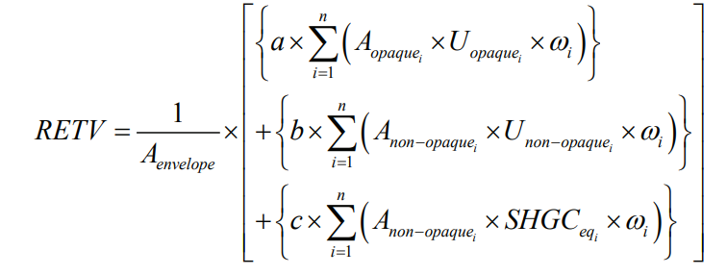
Mandatory Requirement
5.2.1.4- Residential Envelope Transmittance Value (RETV)
Orientation of wall/opening, shading design of fenestration
RETV characterizes the thermal performance of the building envelope (except roof)
RETV is the net heat gain rate (over the cooling period) through the building envelope (excluding roof) of the dwelling units divided by the area of the building envelope (excluding roof) of the dwelling units.
RETV for the building envelope (except roof) shall comply with the maximum RETV of 15 W/m2.
U value of walls and Glass
WWR, SHGC value of glass
RETV
Table – 15: Points for RETV
RETV (W/m²) | Incremental Points
12 ≤ RETV < 15 | Up to 6
6 ≤ RETV < 12 | Up to 36
RETV < 6 | 36
Notes:
Time: 1 minute
RETV measures heat gain through walls and windows, excluding the roof. To comply, RETV must not exceed 15 W/m². Factors that impact the RETV are orientation of wall/opening, shading.., (please refer slide for further info). Continue with the formula (As formula is lengthy, presenter can just point at it). Points for the same can be calculated by referring to table 15

Slide 12
Mandatory Requirement
Strategies that can help reduce heat gain and maintain compliance with the RETV requirement:
Improve insulation with high-quality materials in walls.
Add external shading like overhangs, awnings, or shades.
Apply cool or reflective paints on exterior walls.
Implement ventilated facades with an air gap.
Optimize building orientation to minimize sun exposure
Incorporate plants or vertical gardens for natural shading.
Image source [From Top Left to Right]
1.Architectural digest, Link, 2.Ozbreed, Link, 3.Amazon, Link, 4.Granitech, Link, 5. Researchgate, Link, 6. ele5, Link
Notes:
Time: 20 seconds
Strategies including high quality insulation materials in walls, external shadings, cool/reflective paints, ventilated facades, optimized building orientation and incorporating natural shading will help reduce heat gain and maintain compliance with the RETV requirement.

Slide 13
SUMMARY - Building ENVELOPE
Window Floor area Ratio
RETV < 15
Roof U value: < 1.2W/m2k
Climatic zone | Minimum WFRop (%)
Composite | 12.50
Hot-Dry | 10.00
Warm-Humid | 16.66
Temperate | 12.50
Cold | 8.33
Thermal transmittance of roof (U_{roof}) |  | Maximum score: 4 Points
Additional | 0.28 ≤ U_{roof}< 1.2 | Up to 4 Points
 | U_{roof}< 0.28 | 4 Points
Visible Light transmittance
Residential Envelope Transmittance Value (RETV) | Maximum score: 36 Points
12 ≤ RETV < 15 | Up to 6 Points
6 ≤ RETV < 12 | Up to 36 Points
RETV < 6 | 36 Points
Window-to-wall ratio (WWR)10 | Minimum VLT11
0–0.30 | 0.27
0.31–0.40 | 0.20
0.41–0.50 | 0.16
0.51–0.60 | 0.13
0.61–0.70 | 0.11
Notes:
Time: 30 seconds
This slide is for the audience reference, so that they can just quickly go through all the requirements to comply with building envelope provision.
It is self explanatory. At the presenter can add a point - Proper building envelopes reduce energy consumption and improve occupant comfort.

Slide 14
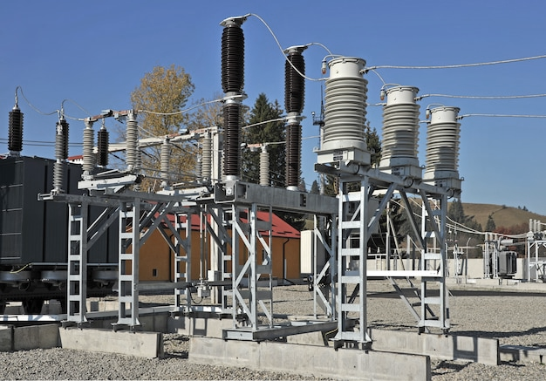
5.2.2 BUILDING SERVICES
5.2.2.1 - Power factor correction
5.2.2.2 - Energy Monitoring
5.2.2.3 - Electric Vehicle Charging System
5.2.2.4 - Electric Systems
5.2.2.5 - Common Area And Exterior Lighting (If Applicable)
5.2.2.6 - Elevators, If Applicable
5.2.2.7 - Pumps, If Applicable
5.2.2.8 - Electrical System, If Applicable
Notes:
Time: 20 seconds
Building services cover various aspects like:
Power factor correction, Energy Monitoring, Electric Vehicle Charging System, Electric Systems, Common Area And Exterior Lighting, Elevators,, Pumps, and Electrical Systems.

Slide 15
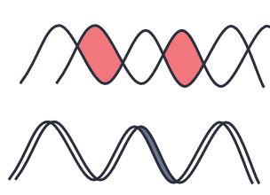
Mandatory Requirement
5.2.2.1- Power Factor Correction
All 3 phase power systems shall be designed to maintain a power factor of 0.97 at the point of connection.
Lag between voltage and current
Before
After
Wasteful lag is reduced to increase energy efficiency
Notes:
Time: 20 seconds
Power factor is a measure of how efficiently an electrical system converts power into useful work (explain this using the image over the slide). So as to comply with the requirement, all 3 phase power systems shall be designed to maintain a power factor of 0.97 at the point of connection.

Slide 16
Mandatory Requirement
5.2.2.2- Energy Monitoring
Applications to be metered
Total electrical energy
Applicable end-uses:
Common area lighting (outdoor, corridor, basement)
Elevators
Water pumps
Basement car parking ventilation
Electricity from power backup
Electricity from renewable energy
Lift pressurization system
Minimum parameters meters should show
Current in each phase (and the neutral wire).
Voltage between phases and between each phase and neutral.
Total Harmonic Distortion (THD), which indicates electrical system quality and ensures the transformers are running efficiently.
Notes:
Time: 30 seconds
To comply with this provision, total electrical energy and applicable end uses like common area lighting.., (please refer to the slide for further info) to be metered. And the meter must show current in each phase, voltage between phases and between each phase and neutral, THD. (presenter can refer to the image that is in the next slide while explaining this).

Slide 17
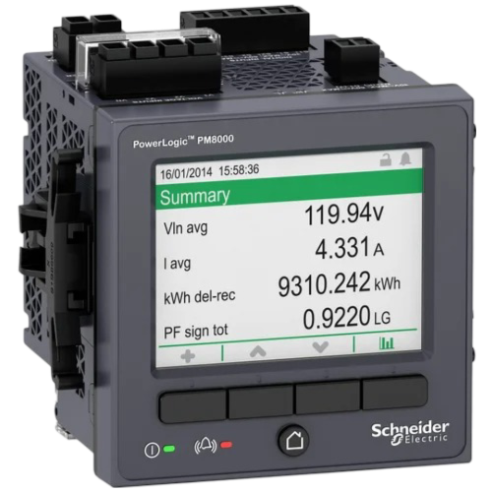
Mandatory Requirement
Meter should be capable of:
Collecting data every 15 minutes.
Providing summaries on hourly, daily, monthly, and yearly energy usage.
Storing data for at least 36 months.
Sending data to a building's control system.
Image source:Indiamart, Link
Notes:
Time: 15 seconds
Continue.., And meter should be capable to collect data every 15 minutes and provide summaries at hourly, daily, and monthly intervals and store data for at least 36 months.

Slide 18
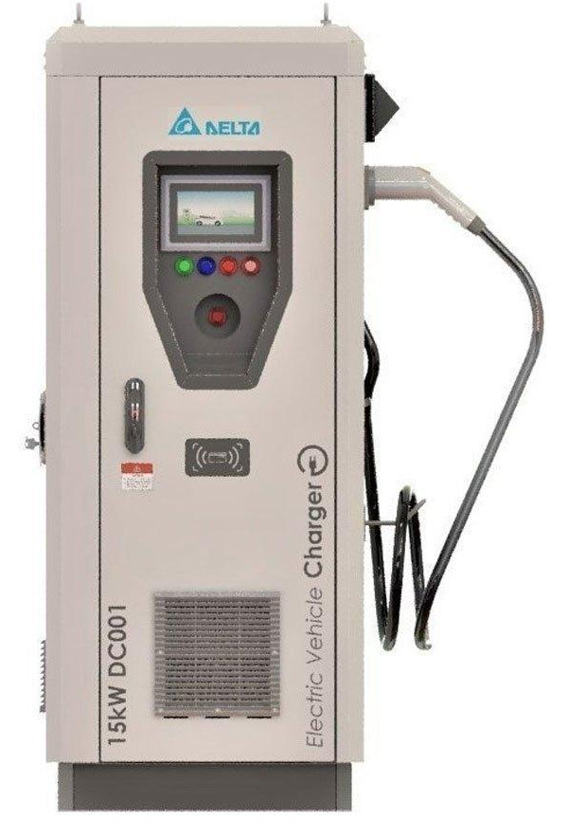
Mandatory Requirement
5.2.2.3- ELECTRIC VEHICLE CHARGING SYSTEM
If an Electric Vehicle Charging Infrastructure is installed, it must comply with the revised guidelines issued by the Ministry of Power for EV Charging Infrastructure on January 15, 2022, or any subsequent amendments.
Single charging gun
Guidelines issued by the Ministry of Power for EV Charging Infrastructure:
Building Type | Plotted House
Ownership of Station | Private (Owner)
Connection and Metering | Domestic meter
Type of Charger | Slow chargers as per owner's specific requirements
Modes of Charging | AC (Single charging gun)
Norms of Provisions | Min. 1 SC and additional provisions as per the owner individual.
Source:Ministry of Power, Link
Image source: Freepik, Link
Notes:
Time: 45 seconds
Electric vehicle charging systems must comply with the latest Ministry of Power guidelines. Presenter can guide the audience referring to the table highlighting the guidelines.

Slide 19
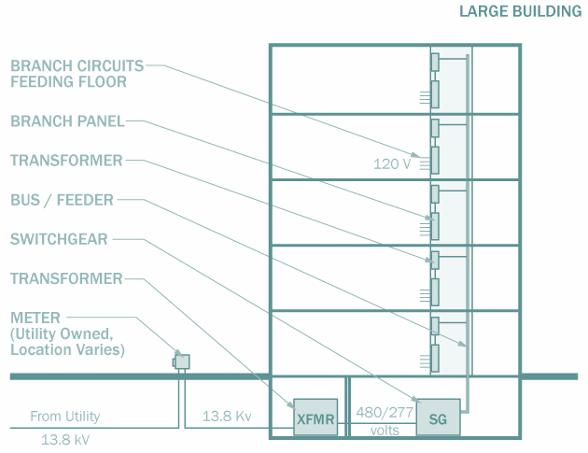
Mandatory Requirement
5.2.2.4- Electrical Systems
Why power loss occurs: When electricity flows through cables, some energy is lost as heat. This is called distribution loss.
Cable Sizing: Using the right cable size helps keep energy loss below 3%, ensuring efficient power use.
Voltage drop (reduction in voltage as electricity travels) should be limited:
Feeders: Max 2% drop.
Branch Circuits: Max 3% drop.
Proper management ensures reliable power delivery and reduces unnecessary energy waste.
Image source: Archtoolbox, Link
Notes:
Time: 30 seconds
Electrical systems play a major role when it comes to energy losses, generally these losses occurs as heat when electricity flows through cables, proper cable sizing, limiting voltage drops of feeders to 2% and 3% for branch circuits can minimize these losses. This ensures reliable power delivery and reduced energy waste.

Slide 20
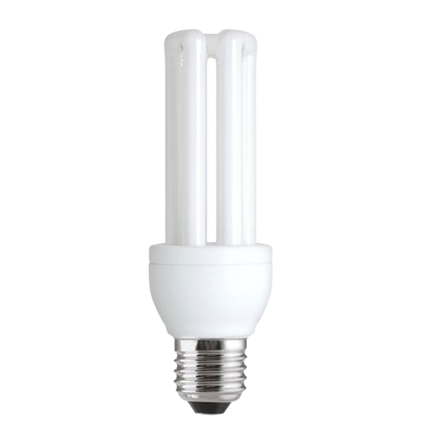
Mandatory Requirement
5.2.2.5- Common Area and Exterior Lighting (If Applicable)
Lighting Power Density (LPD) is the amount of electrical power used by lighting per square meter (W/m²).
Lower LPD means less energy is used, leading to energy savings.
Luminous Efficacy (LE) LE measures how efficiently a light source converts electricity into light (measured in lumens per watt, lm/W). Higher efficacy means more light is produced using less energy.
Efficacy Range of Light Fixtures:
LED (Light Emitting Diodes): 80-120 lm/W (highly efficient, long-lasting)
CFL (Compact Fluorescent Lamps): 50-70 lm/W (moderate efficiency)
FL (Fluorescent Lamps): 60-100 lm/W (used in offices, moderate efficiency)
Notes:
Time: 45 seconds
Quick overview: Lighting efficiency can be achieved through:
Lowering Lighting Power Density (LPD) to reduce energy consumption.
Using fixtures with higher Luminous Efficacy (LE), such as LEDs (80-120 lm/W), which are more efficient than CFLs or fluorescent lamps.

Slide 21
Mandatory Requirement
5.2.2.5- Common Area and Exterior Lighting (If Applicable)
Either the Lighting power density (LPD) or Luminous efficacy (LE) has to be met.
Corridor lighting
Table – 10: Common Area Lighting
Common Areas | Maximum LPD (in W/m2) | Minimum luminous efficacy (lm/W)
Corridor lighting & Stilt Parking | 3.0 | 85 lumens per Watt
Basement Parking | 1.0
Stilt Parking Lighting
Basement Lighting
Image source: Freepik, Link
Notes:
To be continued with the requirements for compliance, rest is self explanatory.

Slide 22
Mandatory Requirement
Driveways
In case of the exterior lighting load being more than 100 W, the lighting fixtures shall use lamps with an efficacy of at least 85 lumens per Watt or meet the maximum LPD requirements given in Table 11
Pedestrian walkways
Table – 11: Outdoor Lighting Requirement
Exterior Lighting Areas/ Zones | Maximum LPD (in W/m2)
Driveways and parking (open/ external) | 1.6
Pedestrian walkways | 2
Stairways | 10
Landscaping | 0.5
Outdoor sales area | 9
Stairways
Landscape
Source: Bureau of Energy Efficiency, Ministry of Power, Government of India
Image source [From Top Left to Right Bottom]
1.Homedepot, Link, 2.Jaguar, Link, 3.Amazon, Link, 4.Freepik, Link,
Notes:
To be continued with the requirements for compliance, rest is self explanatory.

Slide 23
Incremental Provisions
5.3.2 - BUILDING SERVICES
5.3.2.1- Common Area and Exterior Lighting (If Applicable)
All permanent lighting fixtures with a lamp luminous efficacy of at least 95 lm/Watt shall be installed in the areas, as per Table 17.
Table – 17: Points for Common Area Lighting
Area/Zones | Incremental Points
Corridor parking and stilt parking | 1
Basement Lighting | 1
Exterior lighting areas | 1
Notes:
Time: 1 minute
Presenter can highlight lamp luminous efficacy (for complying with incremental provisions, all permanent lighting fixtures should have lamp luminous efficacy of at least 95 lm/Watt).

Slide 24
Incremental Provisions
5.3.2 - BUILDING SERVICES
5.3.2.1- Common Area and Exterior Lighting (If Applicable)
All permanent lighting fixtures excluding emergency lighting installed in areas as per Table 18 shall:
Have a luminous efficacy of 105 lm/Watt
Lamps for all exterior applications shall be controlled by photo sensor or astronomical time switch that is capable of automatically turning off the exterior lighting when daylight is available, or when the lighting is not required.
Table –18: Points for automatic control of exterior lights
Area/Zones | Incremental Points
Corridor parking and stilt parking | 2
Basement Lighting | 2
Exterior lighting areas | 2
Photo sensor
Astronomical time switch
Image source [From Left to Right]
1.Alpscontrol, Link, 2.Indiamart Link,
Notes:
To be continued with highlighting compliance requirements for incremental provisions, all permanent lighting fixtures excluding emergency lighting should have lamp luminous efficacy of at least 105 lm/Watt. Lamps for all exterior applications shall be controlled by photo sensor or astronomical time switch that is capable of automatically turning off the exterior lighting when daylight is available, or when the lighting is not required.

Slide 25
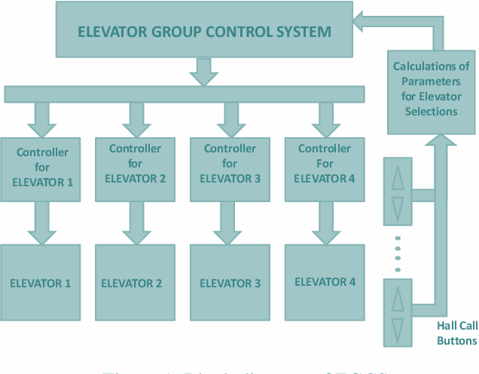
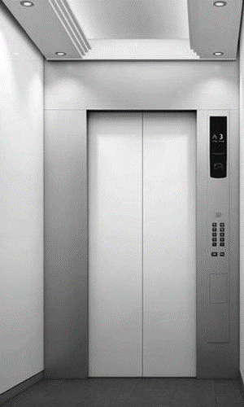
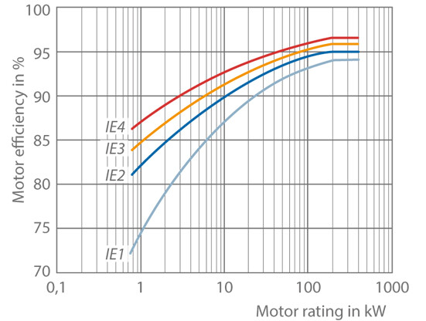
Mandatory Requirement
5.2.2.6- Elevators (If Applicable)
Install high-efficacy lamps for lift car lighting having a minimum luminous efficacy of 85 lm/W.
Install automatic switch-off controls for lighting and fan inside the lift car when are not occupied.
Install minimum class IE 3 high-efficiency motors.
Group automatic operation of two or more elevators coordinated by supervisory control
High Efficacy lamps with Luminous Efficacy of 85lm/w
Image source: Semanticscholar, Link
Auto Switch off for Light & Fan when not in use
IE 3 high-efficiency
Group Automatic with Supervision
Image source: Freepik, Link
Image source KSB, Link,
Notes:
Time: 1 minute 30 seconds
In elevators installing IE motors with at least IE 3 efficiency, automatic switch-off controls for lighting and fans in unoccupied lift cars, and group automatic operation to optimize usage in multi-elevator buildings can lead to energy efficiency.

Slide 26
Incremental Provisions
5.3.2 - BUILDING SERVICES
5.3.2.2- Elevators (If Applicable)
Table – 19: Points for Elevators
Provisions | Incremental Points
Installing variable voltage variable frequency drives | 4
Installing Regenerative Drives | 3
Installing IE4 Motors | 2
Notes:
To be continued within the same timeline. Highlight the incremental points (please refer the table 19) while referring to the successive slides (slide no. 27 & 28).

Slide 27
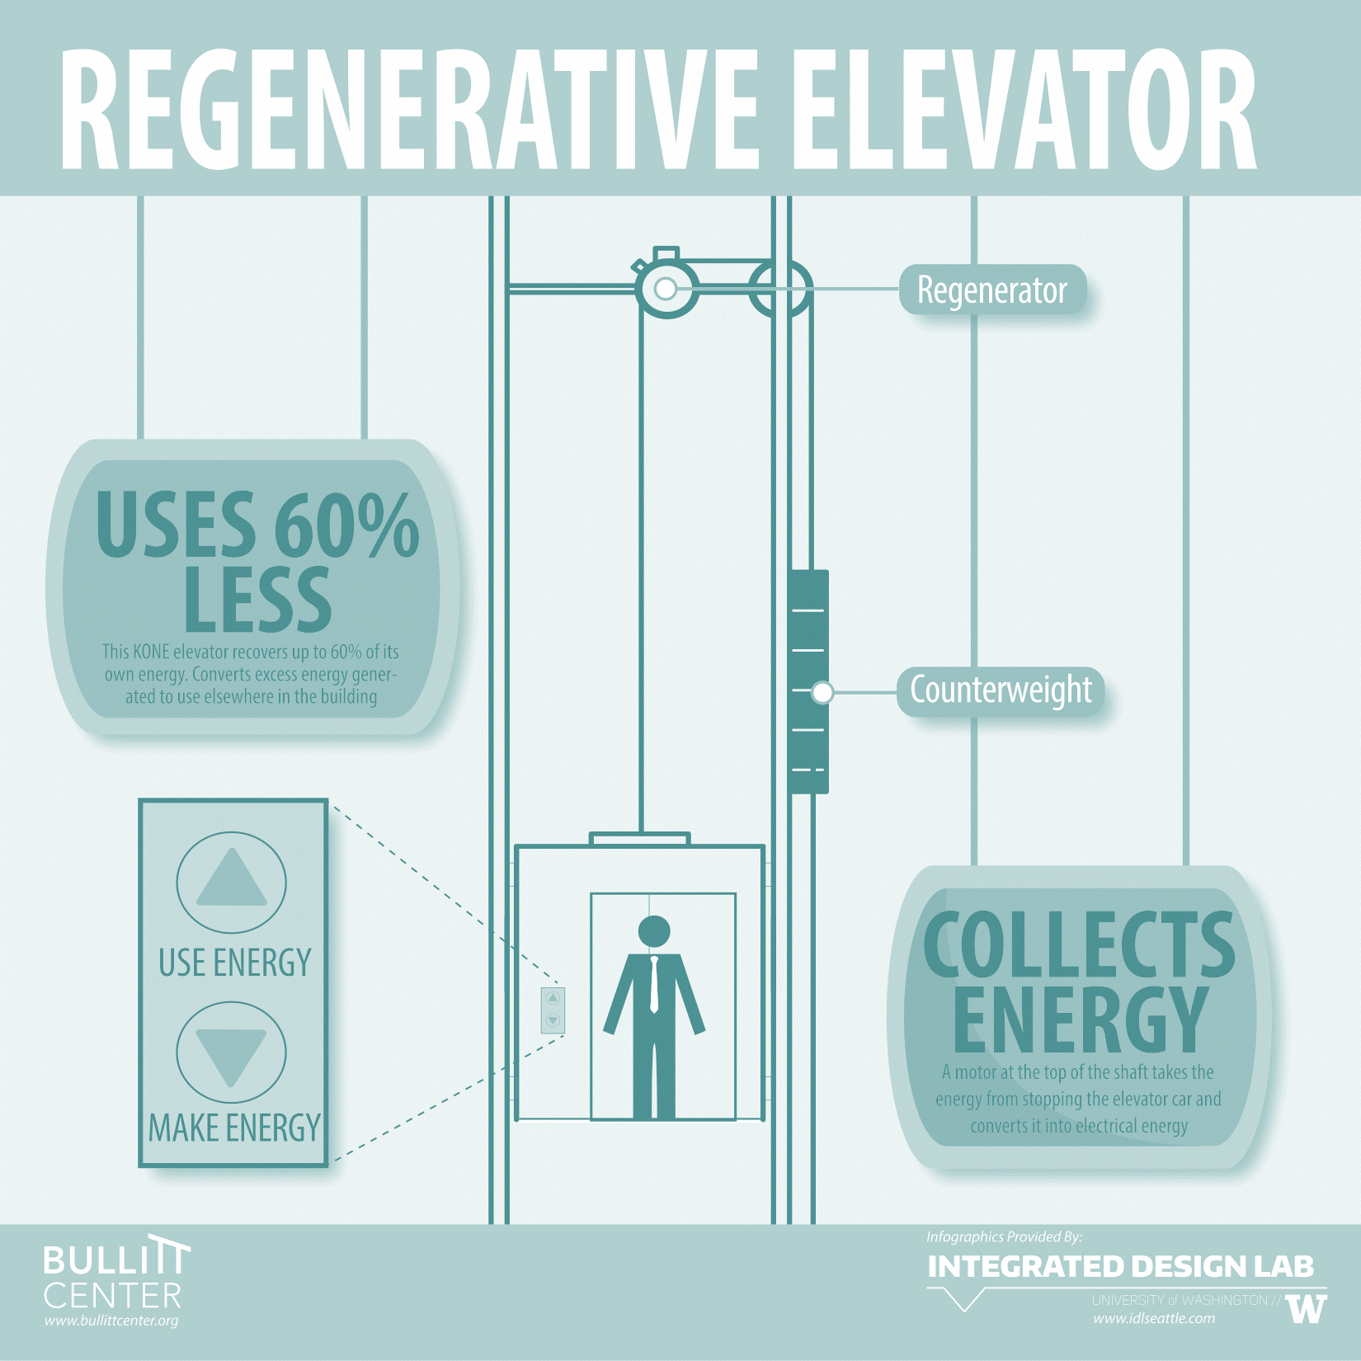
Incremental Provisions
Regenerative drives
Captures the heat generated by elevators during use and convert it into reusable energy for the building rather than wasting it as heat
When power flows into the elevator motor, it creates a lifting torque on the shaft and elevator sheave, lifting the cab.
Image source: Bullittentre, Link
Notes:
To be continued within the same timeline.
Self explanatory.

Slide 28
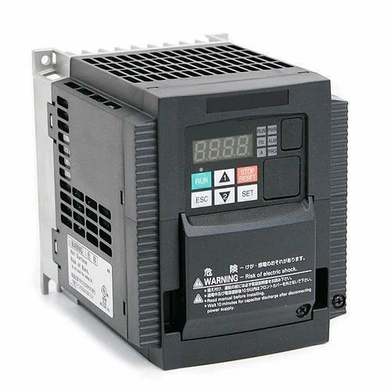
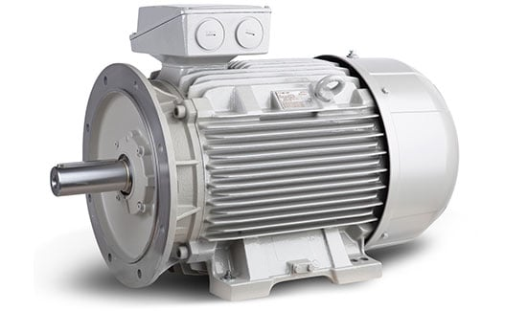
Incremental Provisions
Variable voltage variable frequency drives
IE 4 motor
They adjust the frequency of the electrical supply to control the motor's speed while simultaneously modifying the voltage for optimal performance.
VVVF drives are crucial in modern elevator systems, improving efficiency, comfort, and reliability while reducing energy consumption and maintenance needs
IE4 motors work by using electricity to create a magnetic field that spins a rotor, providing efficient mechanical power for various applications.
IE4 motors are high-efficiency electric motors designed to deliver superior performance with minimal energy loss.
Image source: Indiamart, Link
Image source: Rotor.nl, Link
Notes:
To be continued within the same timeline.
Self explanatory.

Slide 29
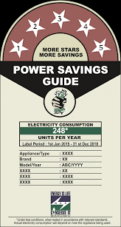
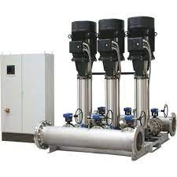
Mandatory Requirement
5.2.2.7- Pumps (If Applicable)
Pumps that are either hydro-pneumatic having a minimum mechanical efficiency of 60% or BEE 4-star rated shall be installed in the building.
Minimum 60% Mechanical Efficiency
BEE Star Rated Pumps
Image source: Archtoolbox, Link
Notes:
Time: 30 seconds
Pumps must have a minimum mechanical efficiency of 60% or be BEE 4-star rated. Efficient pumps reduce operational costs and energy consumption.

Slide 30
Incremental Provisions
5.3.2.3 Pumps (If Applicable)
Table – 20: Points for Pumps
Provisions | Incremental Points
Installation of BEE 5-star rated pumps | 5
Installation of a hydro-pneumatic system for water pumping having minimum mechanical efficiency of 70% | 3
Notes:
To be continued within the same timeline.
Highlight the points w.r.t to the requirements.

Slide 31
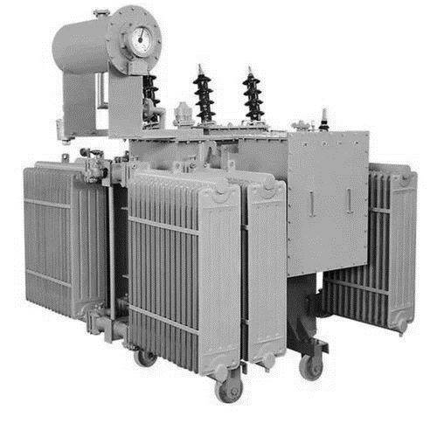
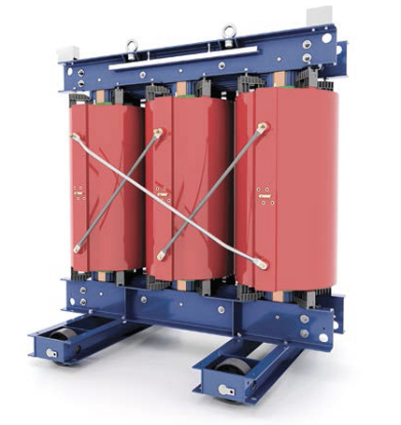
Mandatory Requirement
5.2.2.8- Electrical Systems (If Applicable)
Power transformers of the proper ratings and design must be selected to satisfy the minimum acceptable efficiency at 50% and full load rating. The permissible loss shall not exceed the values listed in Table A for dry type transformers and BEE 4-star rating in Table B for oil type transformers.
All measurements of losses shall be carried out by calibrated digital meters of class 0.5 or better accuracy.
Dry type transformers
Oil type transformers
Notes:
Time: 1 minute
Mandatory requirements for elec systems, power transformers must be selected with proper ratings to ensure minimum acceptable efficiency at 50% and full load ratings and losses should not exceed the permissible limits provided as per Table A and Table B. All measurements of losses shall be carried out by calibrated digital meters of class 0.5 or better accuracy.

Slide 32
Mandatory Requirement
A dry-type transformer does not have any rotating parts
Oil-type transformers use combustible liquids for cooling, making the units highly suitable for outdoor locations
Dry Type Transformers
Oil Type Transformers
This type of transformer is also named as “cast resin type transformers”
it is a motionless device that utilizes eco-friendly temperature insulation systems
Smaller and more compact unit
Oil and liquid-type transformers offer better cooling than dry types
Table – A: Permissible Limit for Dry-Type Transformers
Table – B: Permissible Limit for Oil-Type Transformers
Rating (kVA) | Max. Losses at 50% Loading (W) Up to 22 kV Class | Max. Losses at 100% Loading (W) Up to 22 kV Class | Max. Losses at 50% Loading (W) 33 kV Class | Max. Losses at 100% Loading (W) 33 kV Class
100 | 940 | 2400 | 1120 | 2400
160 | 1290 | 3300 | 1420 | 3300
200 | 1500 | 3800 | 1750 | 4000
250 | 1700 | 4320 | 1970 | 4600
315 | 2000 | 5040 | 2400 | 5400
400 | 2380 | 6040 | 2900 | 6800
500 | 2800 | 7250 | 3300 | 7800
630 | 3340 | 8820 | 3950 | 9200
800 | 3880 | 10240 | 4650 | 11400
1000 | 4500 | 12000 | 5300 | 12800
1250 | 5190 | 13870 | 6250 | 14500
1600 | 6320 | 16800 | 7500 | 18000
2000 | 7500 | 20000 | 8880 | 21400
2500 | 9250 | 24750 | 10750 | 26500
Rating (kVA) | Impedance (%) | BEE 1 Star (50% Load) | BEE 1 Star (100% Load) | BEE 3 Star (50% Load)
16 | 4.5 | 135 | 440 | 108
25 | 4.5 | 190 | 635 | 158
63 | 4.5 | 340 | 1,140 | 270
100 | 4.5 | 475 | 1,650 | 392
160 | 4.5 | 670 | 1,950 | 513
200 | 4.5 | 780 | 2,300 | 603
250 | 4.5 | 980 | 2,930 | 864
315 | 4.5 | 1,025 | 3,100 | 890
400 | 4.5 | 1,225 | 3,450 | 1,080
500 | 4.5 | 1,510 | 4,300 | 1,354
630 | 4.5 | 1,860 | 5,300 | 1,637
1,000 | 5 | 2,790 | 7,700 | 2,460
1,250 | 5 | 3,300 | 9,200 | 3,142
1,600 | 6.25 | 4,200 | 11,800 | 3,753
Notes:
To be continued within the same timeline.
Presenter can just make audience to take a quick glance on this.

Slide 33
Incremental Provisions
5.3.2.4 Electrical Systems (If Applicable)
Table – 21: Points for Electrical System
Provisions | Incremental Points
Provide all oil-type transformers with 5-star ratings | 5
Notes:
To be continued within the same timeline.
Highlight the requirements and corresponding points.

Slide 34
SUMMARY - Building services
Common Area and exterior Lighting |  | Area / Zones |  | Maximum score 6 Points
Minimum | Meet the requirements of either minimum luminous efficacy or maximum LPD given in Table 10, Table 11 |  |  | -
Additional | lamp luminous efficacy of 95 lm/W in | Corridor lighting and stilt parking | 1 Point | Up to 3 Points
 |  | Basement Lighting | 1 Point
 |  | Exterior Lighting Areas | 1 Point
 | lamp luminous efficacy of 105 lm/W in | Corridor lighting and stilt parking | 2 Points | Up to 6 Points
 |  | Basement Lighting | 2 Points
 |  | Exterior Lighting Areas | 2 Points
Notes:
Time: 1 minute
These slides are for the audience reference, so that they can just quickly go through all the requirements to comply with building services provision.
It is self explanatory.

Slide 35
SUMMARY - Building services
Elevators Maximum score |  | 9 Points
Minimum | High efficacy lamps for lift car lighting having minimum luminous efficacy of 85 lm/W Automatic switch-off controls for lighting and fan inside the lift car when are not occupied Minimum class IE3 high efficiency motors Group automatic operation of two or more elevators coordinated by supervisory control | -
Additional | Installing the variable voltage and variable frequency drives. (4 points) Installing regenerative drives. (3 points) Installing class IE4 motors. (2 points) | 9 Points
Notes:
Same applies for this slide too.

Slide 36
SUMMARY - Building services
Pumps Maximum score |  | 8 Points
Minimum | Either hydro-pneumatic pumps having minimum mechanical efficiency of 60% or BEE 4 star rated Pumps | -
Additional | BEE 5 star rated pumps (5 Points) Hydro-pneumatic system having minimum mechanical efficiency of 70% (3 Points) | 8 Points
Electrical Systems Maximum score |  | 5 Points
Minimum | Power transformers of the proper ratings and design must be selected to satisfy the minimum acceptable efficiency at 50% and full load rating. | -
Additional | Providing all oil type transformers with BEE 5 star rating. | 5 Points
Notes:
Same applies for this slide too.

Slide 37
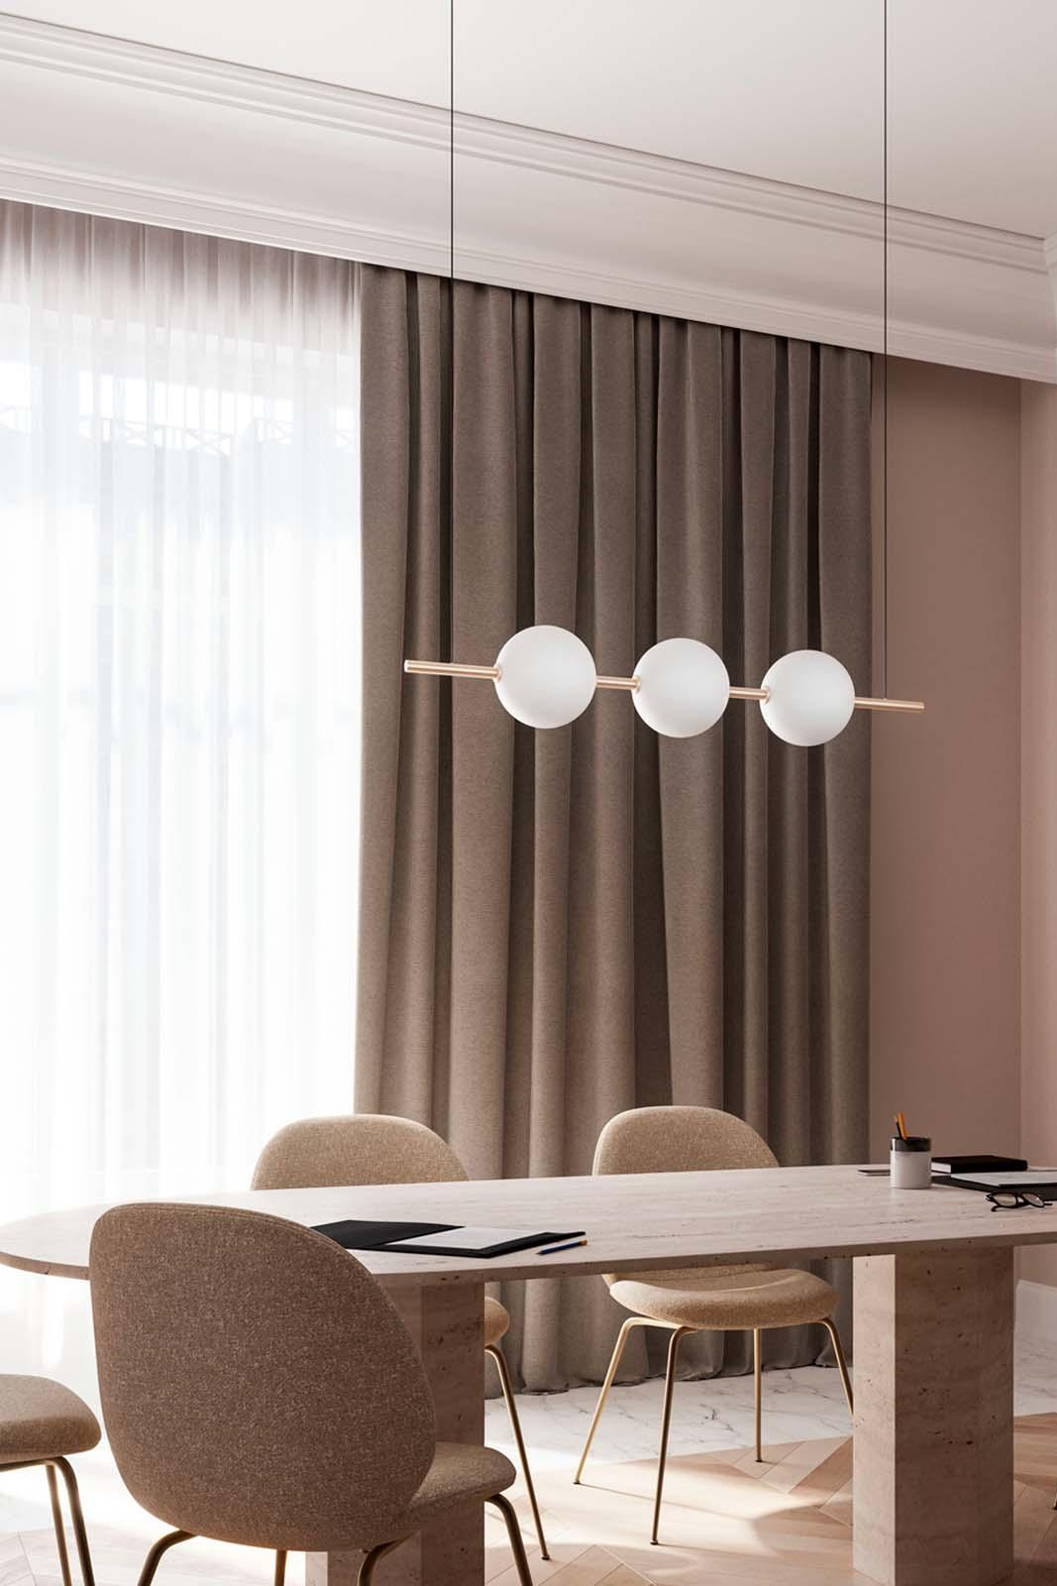
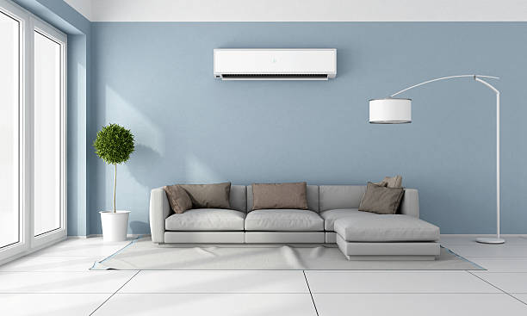
5.2.3
Indoor Electrical Systems
Indoor Lighting
Comfort Systems
Image source: Freepik, Link
Notes:
Time: 20 seconds
Indoor electrical systems cover indoor lighting and comfort systems.
Presenter can start moving to the next slide.

Slide 38
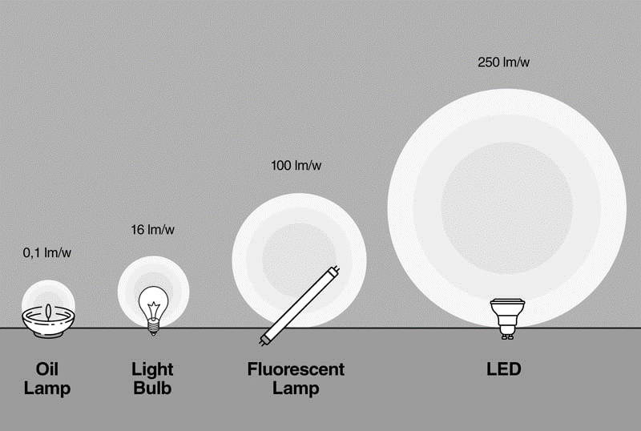
Mandatory Requirement
5.2.3.1- Indoor Lighting
Luminous efficacy is a measure of how well a light source produces visible light
All the lighting fixtures shall have lamps with a luminous efficacy of a minimum of 85 lm/W installed in all the locations.
Image source: Faro, Link
Notes:
Time: 45 seconds
Indoor lighting must meet a minimum luminous efficacy (Luminous efficacy is a measure of how well a light source produces visible light.) of 85 lm/W. This ensures energy-efficient illumination while reducing power consumption.

Slide 39
Incremental Provisions
5.3.3 - INDOOR ELECTRICAL END-USE (IF APPLICABLE)
5.3.3.1 Indoor Lighting
Table – 22: Points for Lamp Lumen Efficacy of Indoor Lighting
Provisions | Incremental Points
Lamp Lumen Efficacy > 95 Lm/W | 3
Lamp Lumen Efficacy > 105 Lm/W | 8
Notes:
To be continued within the same timeline.
Highlight the requirements followed by their corresponding points.

Slide 40
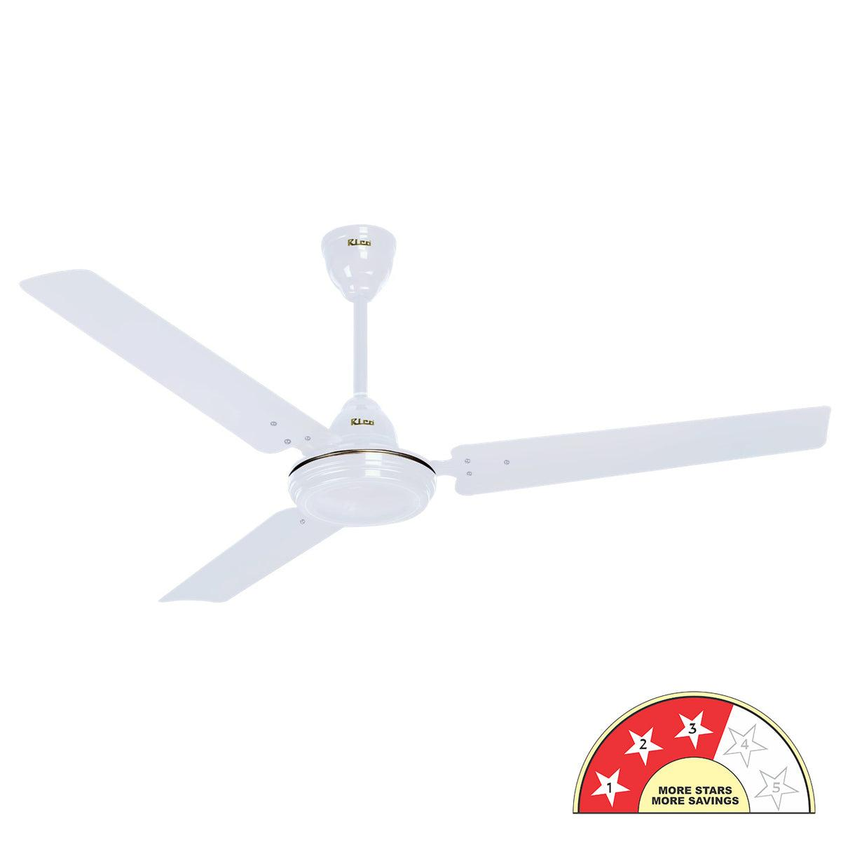
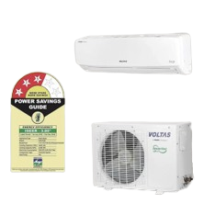
Mandatory Requirement
5.2.3.2- COMFORT SYSTEMS
Ceiling fans:
All ceiling fans installed in all the spaces in all the dwelling units shall have a minimum of 3 star for all sweep sizes
Air Conditioners:
Unitary Type: 5 Star
Split AC: 3 Star
VRF: 3.28 EER, or 4.36 IEER 13(BEE Standards and Labelling requirements of 3 star for VRF shall take precedence over the current minimum requirement)
Chiller: 3 Star
Split AC: 3 Star
Image source: Electronic paradise, Link
Notes:
Time: 1 minute
Ceiling fans and air-conditioners comes under comfort systems, wherein these should meet specific criteria as in ceiling fans should have a minimum of BEE 3 star rating, air conditioners (please refer to the slide for further info on this).

Slide 41
Incremental Provisions
5.3.3 - INDOOR ELECTRICAL END-USE (IF APPLICABLE)
5.3.3.2 Comfort Systems
Table – 24: Points for BEE Star Rating of
Air-Conditioners
Table – 23: Points for BEE star rated ceiling fans
Provisions | Incremental Points
Ceiling fans in all the bedrooms and hall with BEE 4-Star | 1
Ceiling fans in all the bedrooms and hall with BEE 5-Star | 4
Provisions | Incremental Points
Split AC: 4-Star VRF: 3.6 EER Chiller: 4-Star | 9
Split AC: 5-Star VRF: 3.8 EER Chiller: 5-Star | 30
Notes:
To be continued within the same timeline.
Highlight the requirements with the corresponding points.

Slide 42
SUMMARY - INDOOR ELECTRICAL END-USE
Indoor Lighting Maximum score |  | 8 Points
Minimum, If opted | All the lighting fixtures shall have lamps with luminous efficacy of minimum 85 lm/W installed in all bedrooms, hall and kitchen. | -
Additional | 95 lm/w (3 Points) 105 lm/W (8 Points) | Up to 8 Points
Ceiling Fans
Minimum, If opted | All ceiling fans installed in all the spaces in all the dwelling units shall have a minimum of 3 star for all sweep sizes | -
Additional | 4 Star | 1 Point
 | 5 Star | 4 Points
Notes:
Time: 30 seconds
These slides are for the audience reference, so that they can just quickly go through all the requirements to comply with indoor electrical end-use provision.
It is self explanatory.

Slide 43
SUMMARY - INDOOR ELECTRICAL END-USE
Air Conditioners |  | Points
Minimum, If opted | All the bedrooms having air conditioners in all the dwelling units shall have the following specifications: Unitary Type: 5 Star Split AC: 3 Star VRF: 3.28 EER, or 4.36 IEER 13(BEE Standards and Labelling requirements of 3 star for VRF shall take precedence over the current minimum requirement) Chiller: 3 Star | -
Additional | Split AC: 4 Star Chiller: Minimum ECBC+ Level values as mentioned in ECBC 2017 | 9 Points
 | Split AC: 5 Star Chiller: Minimum Super ECBC Level values as mentioned in ECBC 2017 | 30 Points
Notes:
Same applies for this slide too.

Slide 44
5.2.4- RENEWABLE ENERGY SYSTEMS
Solar Water Heating
Solar Photovoltaic
Image source: Freepik, Link
Notes:
Time: 20 seconds
Renewable energy systems include solar water heating and photovoltaics.
Presenter can start moving to the next slide.

Slide 45
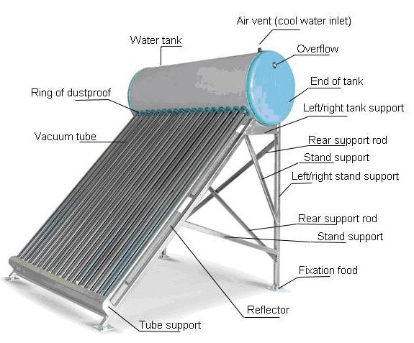
Mandatory Requirement
5.2.4.1- Solar Water Heater
The installed solar water heater shall meet the minimum efficiency level mentioned in IS 13129 Part (1&2).
For the evacuated tube collector: Cover at least 10% of the plot area.
For the evacuated tube collector: Minimum BEE 3-star label.
Solar Water Heater
The storage tanks shall meet IS 16542:2016. The tubes shall meet IS 16543:2016 and IS 16544:2016.
Image source:Wordpress Link
Evacuated tube collector: Efficient solar tube with a vacuum to reduce heat loss, effective even on cloudy days
IS 13129 Part (1&2): Ensure solar water heaters meet minimum efficiency
IS 16542:2016 & IS 16544:2016: Indian Standards for solar water heaters
Notes:
Time: 1 minute
This slide explains the key requirements for solar water heaters as in,
Efficiency Standards: Must meet IS 13129 Part (1 & 2).
Evacuated Tube Collector (ETC):
Cover at least 10% of plot area and must have a BEE 3-star label.
Storage and Tubes:
Storage tanks: IS 16542:2016.
Tubes: IS 16543:2016 and IS 16544:2016.
*Point to the diagram of the solar water heater on the right to highlight the vacuum tubes, storage tank, and other system components as you explain.
For presenter’s ref:
https://www.services.bis.gov.in/php/BIS_2.0/bisconnect/standard_review/Standard_review/Isdetails?ID=MjIyODg%3D – IS 16542:2016
https://www.services.bis.gov.in/php/BIS_2.0/bisconnect/standard_review/Standard_review/Isdetails?ID=MjIyMDQ%3D – IS 16544:2016
https://www.services.bis.gov.in/php/BIS_2.0/bisconnect/standard_review/Standard_review/Isdetails?ID=NDYzOA%3D%3D – IS 13129 part 1
https://www.services.bis.gov.in/php/BIS_2.0/bisconnect/standard_review/Standard_review/Isdetails?ID=NDYzOQ%3D%3D – IS 13129 part 2

Slide 46
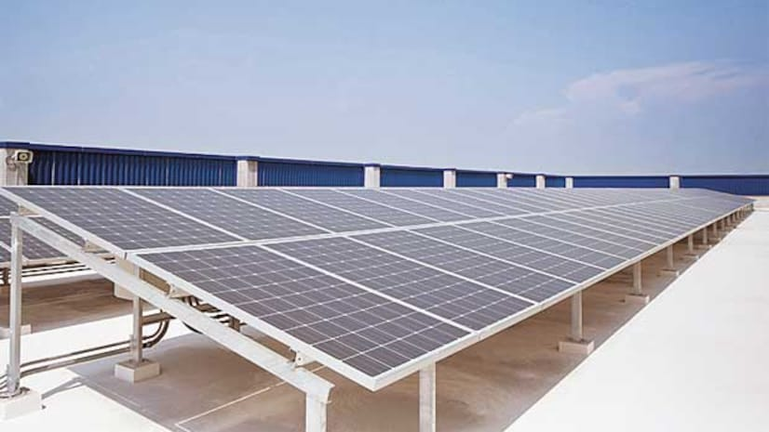
Mandatory Requirement
5.2.4.2 - Solar PhotoVoltaic
Requirements:
The Renewable Energy Generation Zone (REGZ) shall be free of any obstructions within its boundaries.
The zone must also be free from shadows cast by adjacent objects.
It shall comply with the requirement of installing solar photovoltaic systems equivalent to at least 10% of the plot area.
Renewable Energy Generation Zone : A designated area for renewable energy systems
Image source:Business standard, Link
Notes:
Time: 30 seconds
The Renewable Energy Generation Zone (REGZ) must remain free of obstructions within its boundaries and should not be affected by shadows cast by adjacent objects. It is mandatory to install solar photovoltaic (PV) systems covering at least 10% of the plot area to ensure optimal energy generation.

Slide 47
Incremental Provisions
5.3.4 - Renewable Energy Systems
5.3.4.1 - Solar Water Heating and Solar PhotoVoltaic
Table – 25: Points for renewable energy systems
 | Provisions | Incremental Points
Installing Solar Water Heating system of | Minimum BEE 3-star label: Equivalent to at least 13% of the plot area and/or | 4
 | Installing Solar photovoltaic: Equivalent to at least 13% of the plot area
Installing Solar Water Heating system of | Minimum BEE 3-star label: Equivalent to at least 16% of the plot area and/or | 10
 | Installing Solar photovoltaic: Equivalent to at least 16% of the plot area
Notes:
Time: 30 seconds
This slide is for the audience reference, so that they can just quickly go through all the requirements to comply with renewable energy systems provision.
It is self explanatory.

Slide 48
SUMMARY - RENEWABLE ENERGY SYSTEMS
Solar Water Heating and Solar photovoltaic Maximum score |  | 10 Points
Minimum, if opted | The complete system shall comply with the requirements as Solar Water Heating system of minimum BEE 3-star label. The system shall be installed in at least 10% of the plot area. | -
Additional | At Least 13% of the plot area | 4 points
 | At Least 16% of the plot area | 10 points
Notes:
Same applies for this slide too.

Slide 49
LIST OF REQUIRED COMPLIANCE DOCUMENTS
Construction drawings and specifications shall show all pertinent data and features of the building, equipment, and systems in sufficient detail to permit the authority having jurisdiction to verify that the building complies with the requirements of this code.
Notes:
Time: 20 seconds
Self explanatory.
Point to slide and explain what documents are required for compliance.

Slide 50
LIST OF REQUIRED COMPLIANCE DOCUMENTS
Details shall include, but are not limited to:
Building envelope: opaque construction materials and their thermal properties including thermal conductivity, specific heat, density along with thickness; fenestration U-factors, solar heat gain coefficients (SHGC), visible light transmittance (VLT), overhangs and side fins and operable window area.
Building services: Common area lighting (lamp efficacy for lamps and their controls), pump efficiencies; elevator technologies and their controls, transformer losses, power distribution losses, power factor
correction devices; basement ventilation controls, efficiency of EV charging infrastructure and electric check metering and monitoring system.
Indoor electrical end-use: Indoor lighting (type, number, and wattage of lamps and ballasts; automatic lighting shutoff, occupancy sensors, and other lighting controls); ceiling fans star labelling; service hot water type and their efficiency, air- conditioners (system and equipment types, sizes, efficiencies, and controls)
Renewable energy systems: system peak generation capacity, solar water heating system; technical specifications, renewable energy zone area.
Notes:
Time: 40 seconds
Self explanatory.
Point to slide and explain what documents are required for compliance.

Slide 51
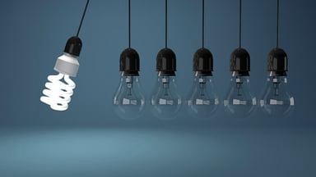
SUMMARY
Focuses on energy management and conservation for residential buildings.
It provides guidelines for reducing energy consumption during and after occupancy using passive and active strategies, and integrating renewable energy systems.
Key areas include building envelope, building services, indoor electrical use, and renewable systems.
Notes:
Time: 25 seconds
To summarize, energy management focuses on building envelopes, services, electrical systems, and renewable energy. These measures collectively ensure sustainability, efficiency, and reduced operational costs.

Slide 52
It’s time for a quick knowledge check!
Notes:
Time- 10 Sec

Slide 53
SCAN ME for the quiz!
Notes:
Time- 45 Sec

Slide 54
1. What is the maximum allowable U-roof value for thermal transmittance in W/m²K?
1) 0.8
2) 1.0
3) 1.5
4) 1.2
Notes:
Time- 30 Sec
Ans: 3) FOUR

Slide 55
2. What is the mandatory minimum efficiency
requirement for chiller units?
1) 2 Star
2) 3 Star
3) 4 Star
4) 5 Star
Notes:
Time- 30 Sec
Ans: 3) 150-200 mm

Slide 56
3. Which lighting option has the highest
luminous efficacy range?
1) CFL
2) LED
3) FL
Notes:
Time- 30 Sec
Ans: 3) 150-200 mm

Slide 57
4. If you want to maximize daylight without increasing heat, which glass property would you focus on?
1) High U Value
2) High VLT
3) Low RETV
Notes:
Time- 30 Sec
Ans: 3) 150-200 mm

Slide 58
5. What percentage of the plot area should the installed solar water heating system cover?
1) Atleast 5%
2) Atleast 10%
3) Atleast 15%
4) Atleast 20%
Notes:
Time- 30 Sec
Ans: 3) 150-200 mm

Slide 59
6. How frequently should energy data be collected for monitoring in residential buildings?
1) Every Hour
2) Every 30 minutes
3) Every 15 minutes
4) Every 20 minutes
Notes:
Time- 30 Sec
Ans: 3) 150-200 mm

Slide 60
7. What is used to reduce power loss in cables?
1) Smaller Cable Size
2) Correct Cable Sizing
3) Larger Voltage Drop
Notes:
Time- 30 Sec
Ans: 3) 150-200 mm

Slide 61
8. Imagine you have two buildings: one with a higher U-roof value and another with a lower U-roof value. Which building will have more heat gain in summer?
1) The building with a higher U-roof
2) The building with a lower U-roof
Notes:
Time- 30 Sec
Ans: 3) 150-200 mm

Slide 62
Let’s see how you scored!
Notes:
Time- 10 Sec

Slide 63
THANK YOU!

