Slide 1
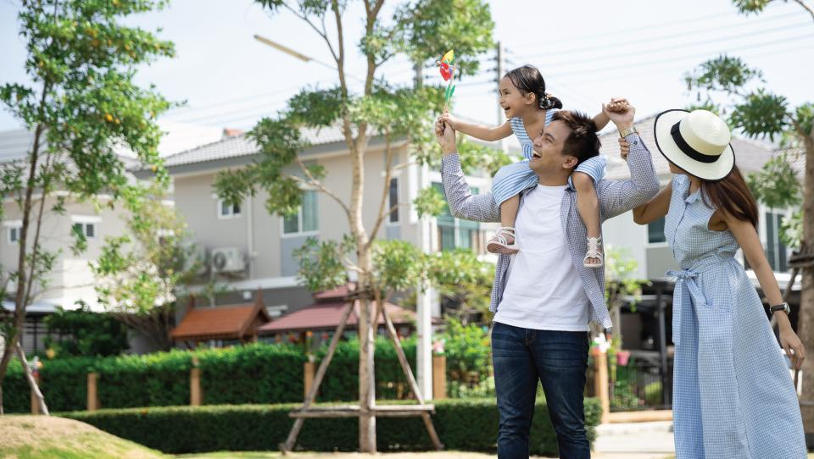
ENS 2024
Indoor Environmental Quality (IEQ) Module
Prepared by : LCES
Created Jan 2025
Notes:
Time- 45 Sec
The Eco Niwas Samhita is a set of guidelines focused on sustainable residential building practices in India.
The code got amended in 2024 with sustainable practices and it is also called ECSBC for residential buildings .

Slide 2
RETV stands for Residential Envelope Transmittance Value. It measures the energy performance of building envelope (walls, roof & windows) by evaluating heat gained or lost through it.
Window to Wall ratio (WWR) is a ratio of the total area of windows to the total area of exterior walls for a building envelope.
Air Change per Hour (ACH) is a measurement of how often the air in a space is replaced with new or recirculated air
U Value also known as Thermal Transmittance measures the rate of heat transfer through material or structure. It indicates how well a material allows heat to pass through it.
Visible Light Transmission (VLT), refers to the percentage of visible light that passes through a material, typically used in the context of window films, sunglasses.
UDI stands for Useful daylight Illuminance, it is a metric that measures the percentage of time when daylight illuminance is within a useful range.
Colour Rendering Index (CRI) is a measure of how accurately a light source displays the true colours of objects compared to a natural reference, like sunlight.
Volatile Organic Compound (VOC) stands for the - class of chemicals that easily evaporate into the air at room temperature. They are present in paints, varnishes, adhesives, cleaning supplies and even furniture.
Important terminologies
Notes:
Explain the basic terminologies that are associates with the factors, affecting IEQ. - 5 mins

Slide 3
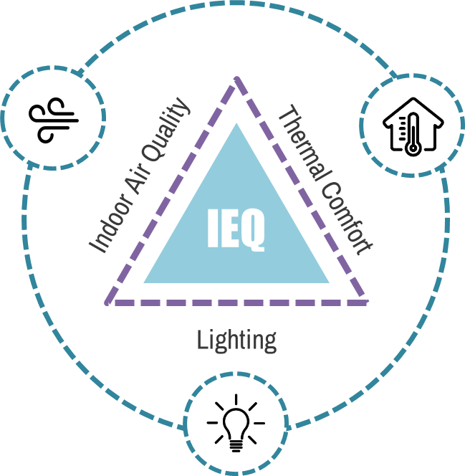
Indoor Environmental Quality (IEQ)
Intent
To provide provisions related to indoor air quality, thermal comfort and visual comfort post-occupancy of a building.
Image source:Freepik, Link
Source: LCES - Author
Notes:
Explain about the factors associated to define the Indoor environment quality of the space. – 2 mins

Slide 4
Ventilation
Potential
Thermal
Comfort
Low Emitting Materials
IEQ
refers to the
quality of a buildings indoor environment in relation to the health and wellbeing of those who occupy space within it
Lighting quality – colour rendering index
Air Quality in Car Parking
MANDATORY PROVISIONS
Lighting adequacy for common area & exterior lighting
Ventilation opening in Kitchen & Bathrooms / Toilets
Daylight
Availability
Source: LCES - Author
Notes:
Explain the mandatory provisions associated with IEQ module – 3 mins

Slide 5
Ventilation Potential
Low- Emitting Material
To meet the minimum criteria for openable window to floor area ratio to ensure adequate potential for natural ventilation
Paints used on the interior side of the building envelope shall comply with VOC content limits as below:
Flat Paints – 50 g/L less water
Non-flat paints - 50 g/L less water
SCOPE
Air Quality in Car Parking
VENTILATION OPENING IN KITCHEN & BATHROOMS / TOILETS
For an enclosed parking areas, a well designed ventilation and exhaust system shall be installed that provides a minimum of 6 air changes per hour as per the National Building Code (NBC) to effectively eliminate vehicle exhaust fumes and pollutants
To provide an opening and/or ventilator in addition to window above the lintel level for installation of exhaust system in kitchen and bathrooms / toilets.
Notes:
Time- 120 Sec
The focus is on preserving the natural features of a construction site during and after development. Buildings should be designed for universal accessibility, catering to individuals with disabilities, the elderly, and children. Efforts should be made to minimize changes to the site's topography and promote landscaped areas. Additionally, measures should be taken to reduce the urban heat island effect by decreasing heat radiation from urban spaces.

Slide 6
DAYLIGHT AVAILABILITY
Lighting adequacy for common area & exterior lighting
To meet the minimum criteria for Visible Light Transmittance (VLT) to ensure adequate availability of daylight.
Artificial Lighting Systems to comply with minimum recommended lux levels
SCOPE
Lighting Quality - Color Rendering Index
THERMAL COMFORT
To achieve maximum Residential Envelope Transmittance Value (RETV), Openable Window-to-floor area ratio and Maximum thermal transmittance of roof and building envelope.
To achieve colour rendering index (CRI) value for each zone within the building.
Notes:
Time- 120 Sec
The focus is on preserving the natural features of a construction site during and after development. Buildings should be designed for universal accessibility, catering to individuals with disabilities, the elderly, and children. Efforts should be made to minimize changes to the site's topography and promote landscaped areas. Additionally, measures should be taken to reduce the urban heat island effect by decreasing heat radiation from urban spaces.

Slide 7
FRAMEWORK of INDOOR ENVIRONMENTAL QUALITY - Mandatory provisions
Ventilation Potential
Low Emitting Materials
Air Quality in Car Parking
Ventilation Openings in Kitchen & Bathrooms / Toilets
Daylight Availability
Lighting adequacy for common area & exterior lighting
Lighting quality – colour rendering index
Thermal Comfort
Notes:
Explain the framework of mandatory requirements, and the sections are previously summarized in the slide. – 2 mins

Slide 8
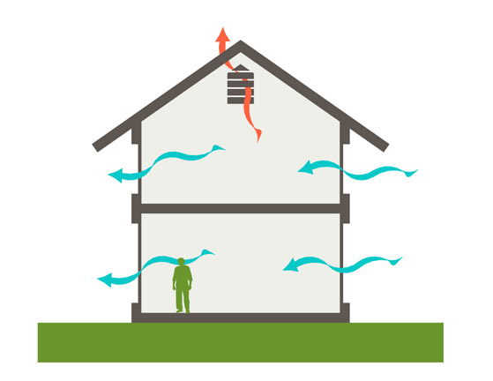
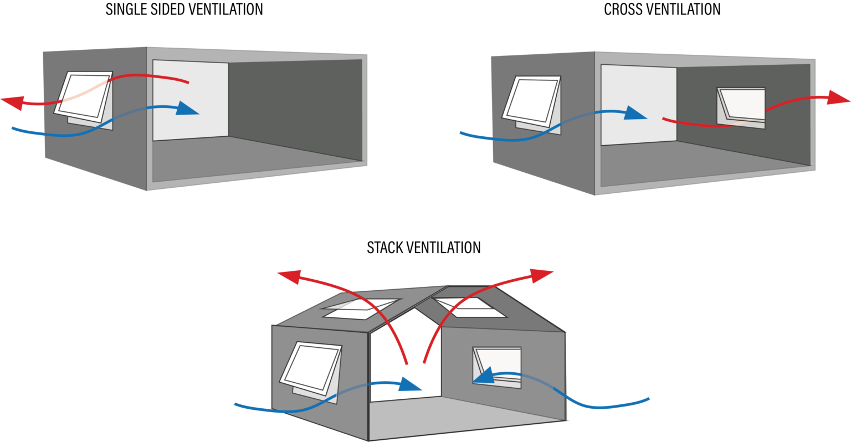
MANDATORY PROVISION
Daylight Availability
The building shall meet the minimum criteria for the openable window-to-floor area ratio (WFR op) to ensure an adequate potential for natural ventilation as per following table:
Image source: Architropics, Link
S.No. | Climatic Zone | Minimum WFR op (%)
1 | Composite | 12.50
2 | Hot-Dry | 10.00
3 | Warm-Humid | 16.66
4 | Temperate | 12.50
5 | Cold | 8.33
Image source:Specvent, Link
Notes:
Explain the concept of window to floor area ratio and explain the standards for the same that are categorized as per the climatic zones. - 5 mins

Slide 9
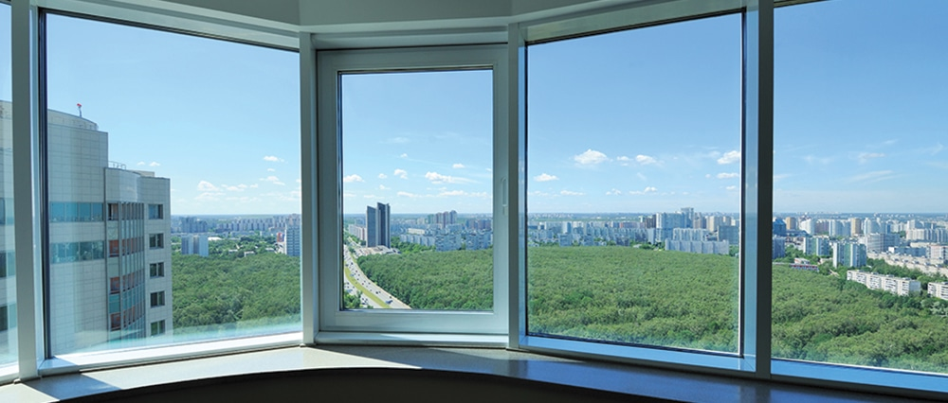
MANDATORY PROVISION
Ventilation Potential
Image source: Peakwindows, Link
Image source: Slideshare, Link
Notes:
Explain the formula to calculate WFR _{op} , also explain each terms defined in the formula. - 5 mins

Slide 10
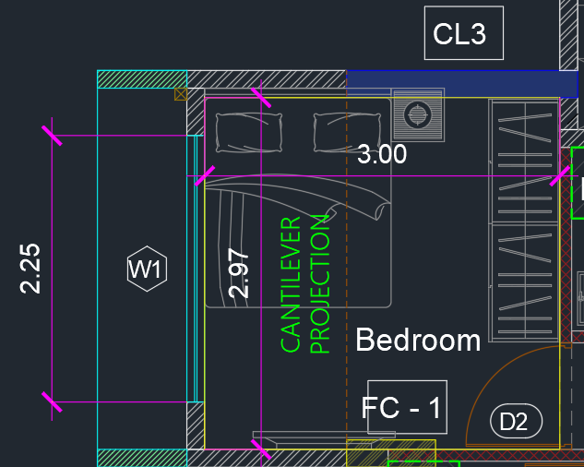
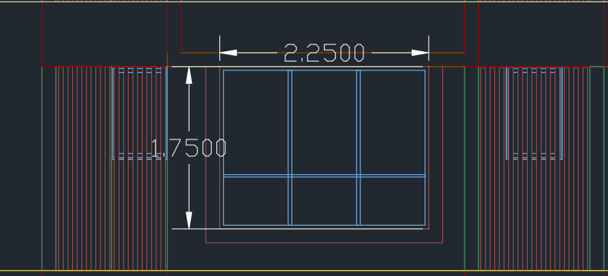
MANDATORY PROVISION
Ventilation Potential
Calculating window-to-floor ratio for a sample flat. (Refer images beside)
Carpet Area of Bedroom = 3*2.97 = 8.91 sq.m
Window Dimensions = Width = 2.25, Height = 1.75.
Total Window area = 2.25*1.75 = 3.93 sq.m
As per the design of window shutters, it is clear that the openable area is 2/3 (66.67%) of total window area. is,
Openable window area = 3.93*0.667 = 2.62 sq.m.
Openable window-to-floor ratio = 2.62/8.91 = 0.29
Sample Flat
Sample Window Schedule
Source: LCES - Author
Sample Window Dimension
Notes:
Explain how to carryout the calculations of WFR _{op} considering a sample flat. - 5 mins

Slide 11
MANDATORY PROVISION
Low Emitting Potential
Image source: Grasim, Link
Paints used on the interior side of the building envelope shall comply with the VOC content limit as per below table:
S.No. | Type of Materials | VOC* Limit (g/L less water)
1 | Flat Paints* | 50
2 | Non-flat Paints* | 50
*Flat Paints, also known as matte paints are type of paint finish that lacks gloss or sheen. They have smooth, non-reflective surface which means they don’t reflect much light.
*Non-flat paints are paint with glossier or shinier finish than flat/matte paint. These finishes have varying degrees of sheen, making them more durable, reflective and suitable for high-traffic or moisture-prone areas.
Image source: Eabassoc, Link
Notes:
Start by discussing VOC, flat paint, and non-flat paint, followed by an explanation of the VOC limits for the same. - 5 mins

Slide 12
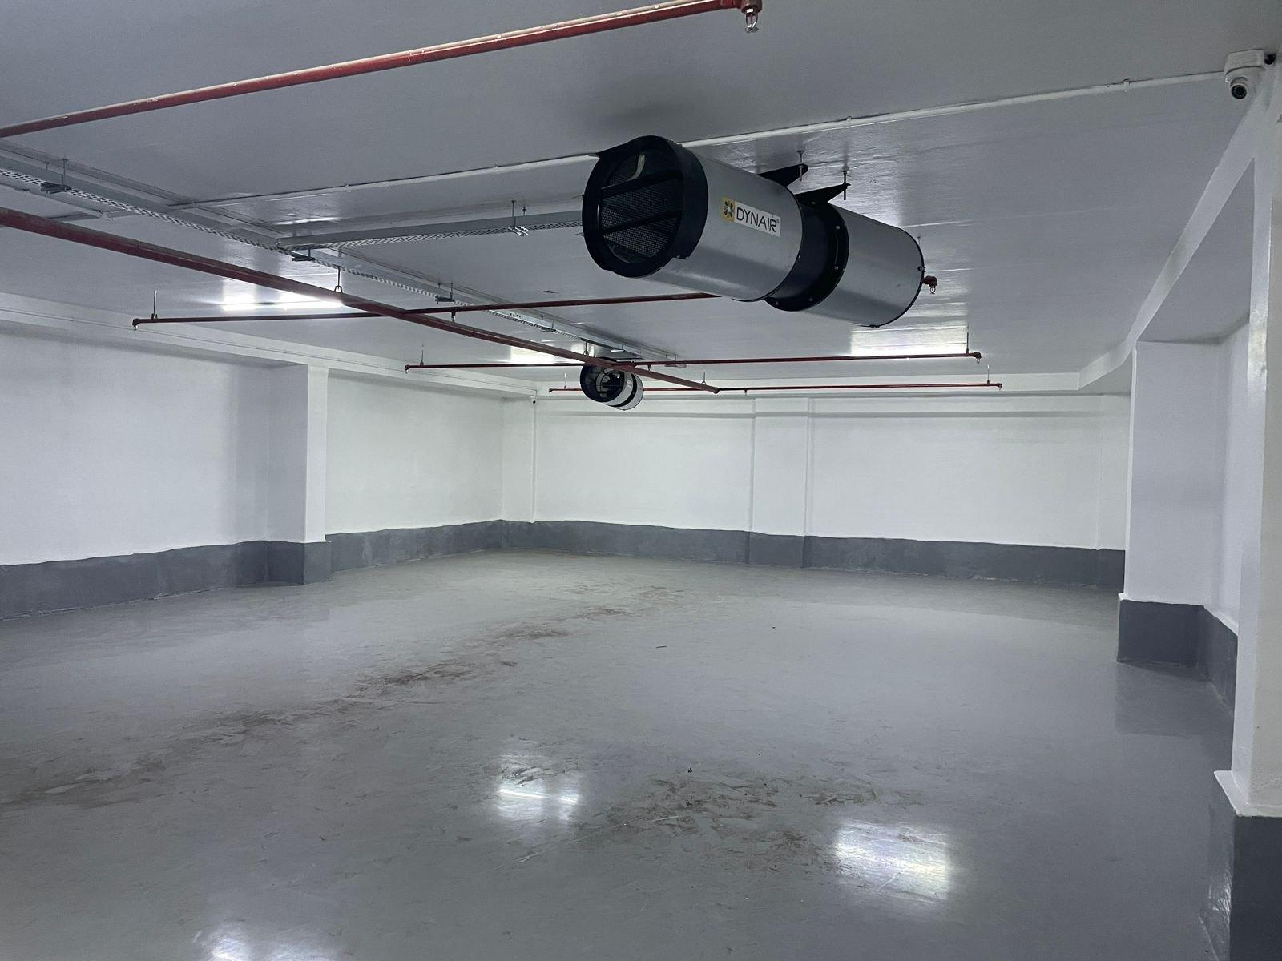
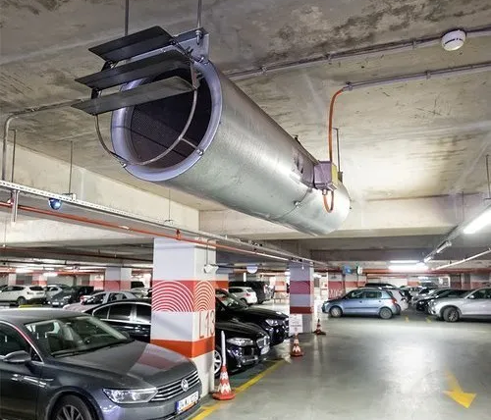
MANDATORY PROVISION
Air Quality in Car Parking
For enclosed parking areas, a well designed ventilation and exhaust system shall be installed that provides a minimum of 6 air changes per hour, as per the National Building Code (NBC), to effectively eliminate vehicle exhaust fumes and pollutants.
Air Change per Hour =
Where,
Q = Airflow Rate (m/h)
V = Volume of the space (m3)
Image source: imimg, Link
Image source: imimg, Link
Notes:
Explain about the concept of ACH and then specify the requirements for the parking area. - 5 mins

Slide 13
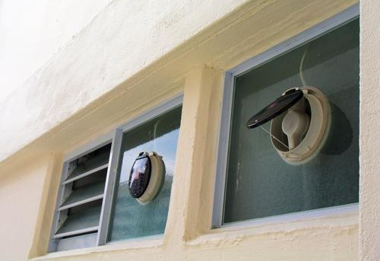
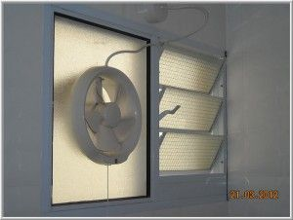
MANDATORY PROVISION
Ventilation Opening in Kitchen and Bathrooms/Toilets
Image source: Encrypted, Link
An opening and/or ventilator shall be provided, in addition to the window, above the lintel level for the installation of exhaust systems in the kitchen and bathrooms/toilets.
Image source:: Pinterest, Link
Notes:
Explain about the mandatory requirement to provide ventilators in kitchen and bathroom spaces to replaces the indoor space with fresh air. - 5 mins

Slide 14
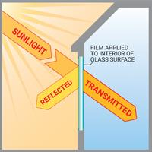
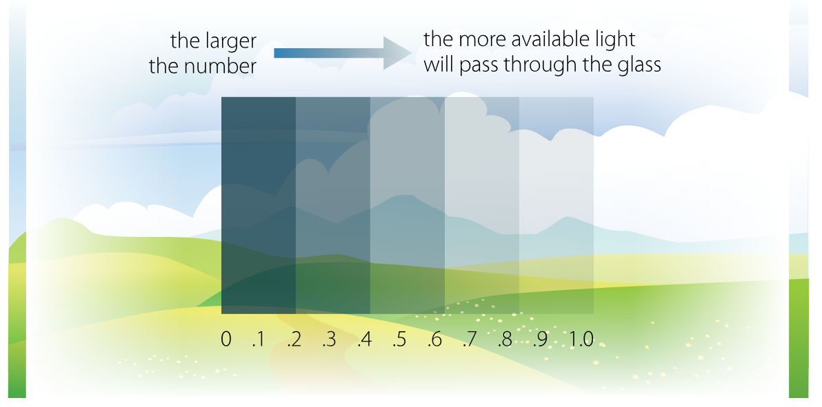
MANDATORY PROVISION
Daylight Availability
The building shall meet the minimum criteria for Visible Light Transmittance (VLT) to ensure adequate availability of daylight as per below table:
Image source: Johnson Window Flims, Link
S.No. | Window-to-wall ratio (WWR) | Minimum VLT*
1 | 0-0.30 | 0.27
2 | 0.31-0.40 | 0.20
3 | 0.41-0.50 | 0.16
4 | 0.51-0.60 | 0.13
5 | 0.61-0.70 | 0.11
* VLT measures how dark or transparent a surface is, with higher percentages indicating more light passing through.
Image source: Bayviewwindows, Link
Notes:
Explain the concept of VLT and then elaborate on the minimum criteria to meet for VLT with variance in the WWR. - 5 mins

Slide 15
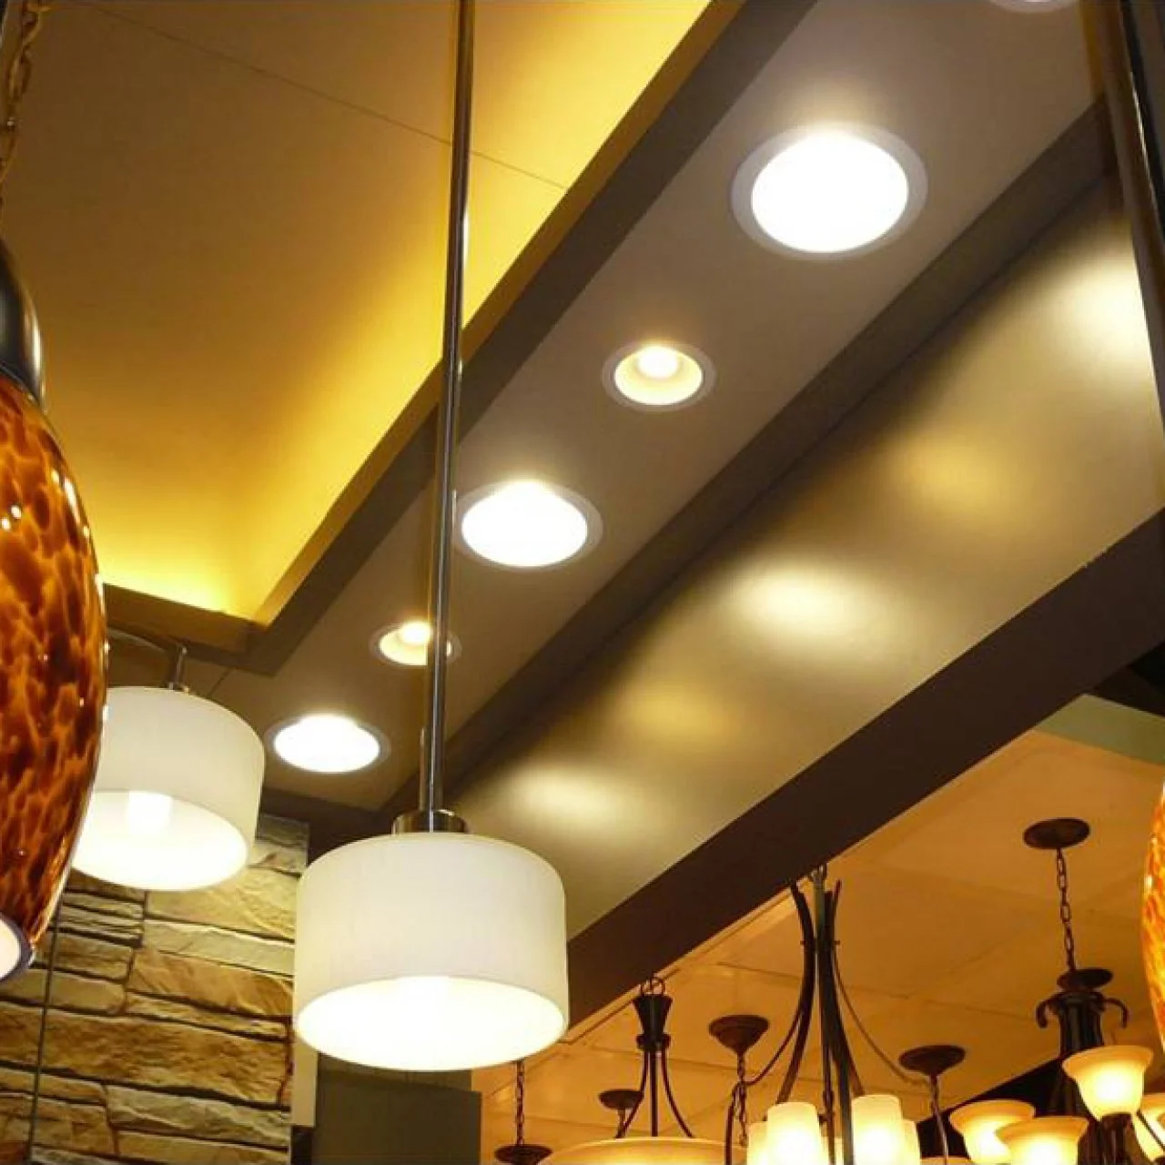
MANDATORY PROVISION
Lighting Adequacy For Common Areas & Exterior Lighting
Artificial Lighting Systems Complying with the minimum recommended lux levels specified as per below table shall be installed:
S.No. | Area Name | Minimum Lux Level
1 | Corridor Lighting & Still Parking | 100
2 | Basement Lighting | 70
External Lighting Areas
3 | Driveways & Parking (Open / External) | 5-20
4 | Pedestrian Walkways | 50
5 | Stairways | 100
Indoor Lighting (If Applicable)
6 | Kitchen | 200
7 | Bathroom | 100
8 | Reading / Study | 300
Image source:: hgtvhome, Link
Notes:
Explain about the requirement of varied illuminance levels based on the functionality of the spaces with reference to the recommended minimum lux levels. - 5 mins

Slide 16
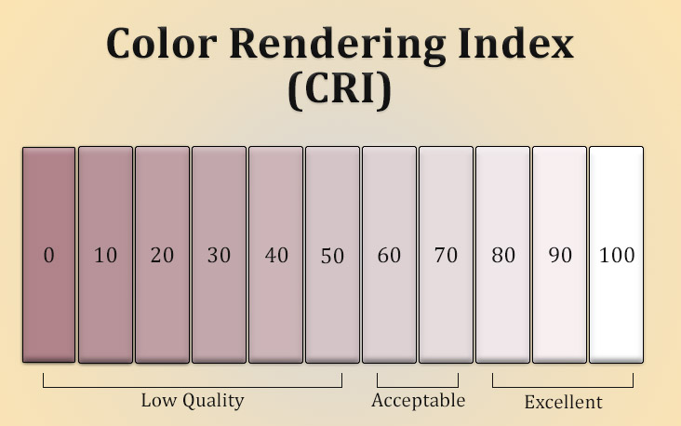
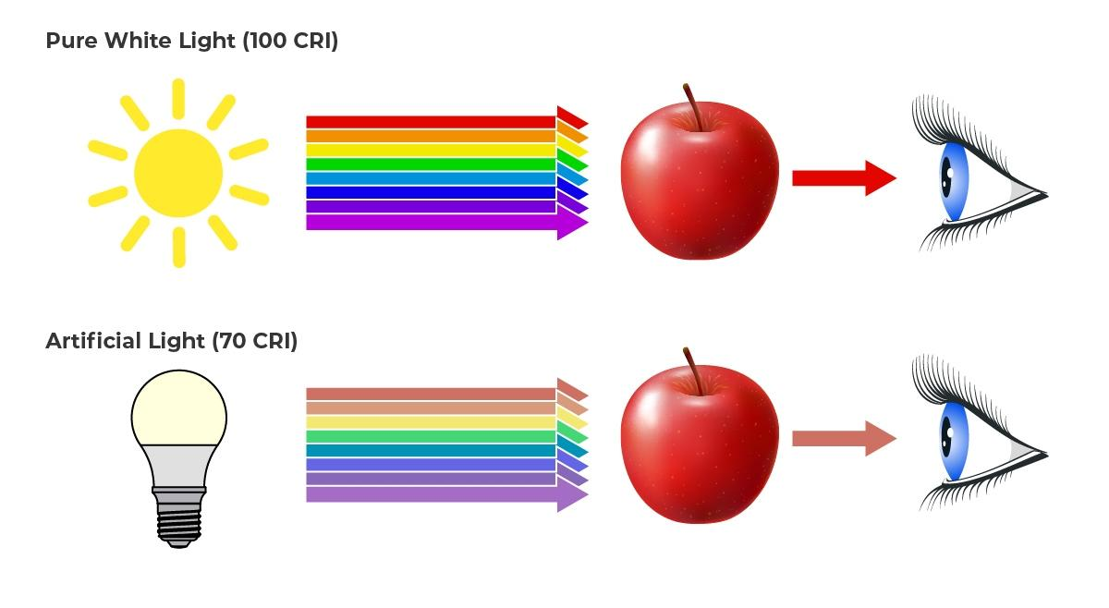
MANDATORY PROVISION
Lighting Quality – Colour Rendering Index
CRI is measured on a scale from 0 to 100, with higher CRI values indicating better color accuracy. Following are Examples of CRI values across light sources:
Image source: Straitslighting, Link
Light Source | Typical CRI Value | Effect on Colours
Sunlight (Reference) | 100 | All colours appears vivid & accurate.
Incandescent Bulb | ~ 100 | Warm & Accurate Colour Rendering.
Halogen Light | ~ 95-100 | Excellent for True Colour Representation.
High-quality LED Light | 80-98 | Colours are vibrant, close to natural appearance.
Standard Fluorescent Light | 60-80 | Colours may appear slightly dull or washed out.
Low Pressure Sodium Lamp | ~0 | Poor Rendering – everything appears yellow or gray
Image source: Superbrightleds, Link
Notes:
Explain the concept of CRI with examples of varies light sources mentioned in the table. - 5 mins

Slide 17
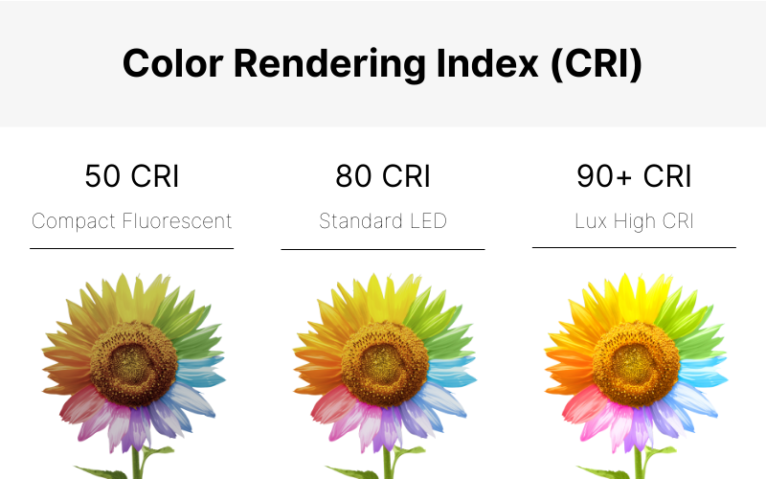
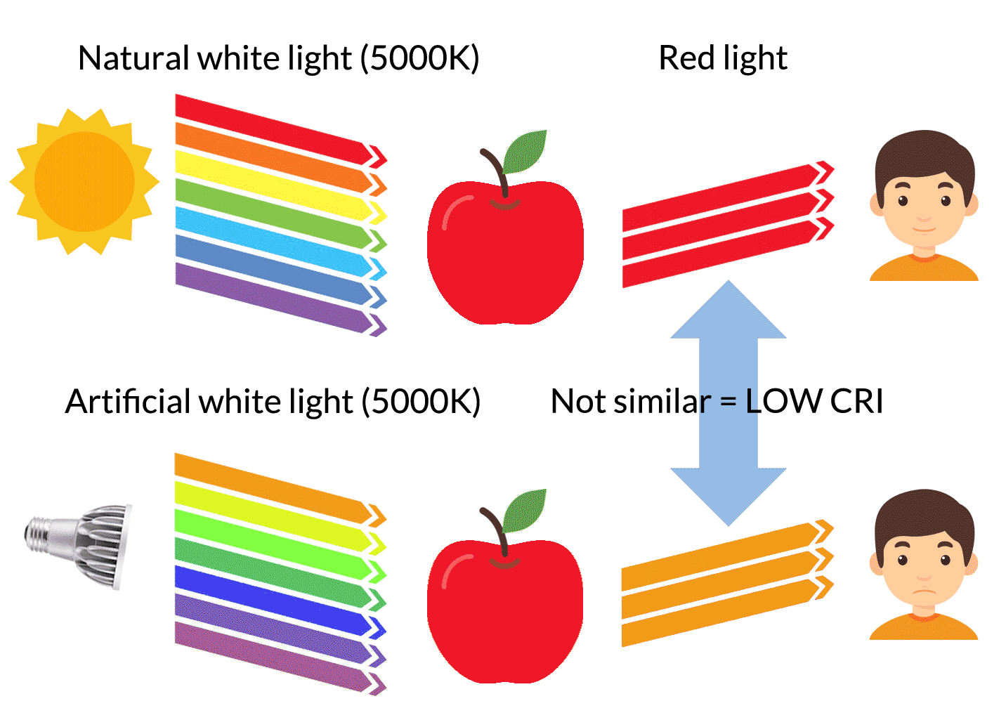
MANDATORY PROVISION
Lighting Quality – Colour Rendering Index
CRI values for each zone within the building shall comply with the requirements as per below table:
S.No. | Area Name | Ra (General Colour Rendering Index
1 | Corridor Lighting & Still Parking | 80
2 | Basement Lighting | 70
External Lighting Areas
3 | Driveways & Parking (Open / External) | 70
4 | Pedestrian Walkways | 70
5 | Stairways | 80
Indoor Lighting (If Applicable)
6 | Kitchen | 90
7 | Bathroom | 80
8 | Bedroom | 80
9 | Reading / Study | 90
10 | Living Room | 90
Image source: Olamled, Link
Image source: Waveform, Link
Notes:
Brief about the CRI value requirements levels based on the functionality of the spaces. - 5 mins

Slide 18
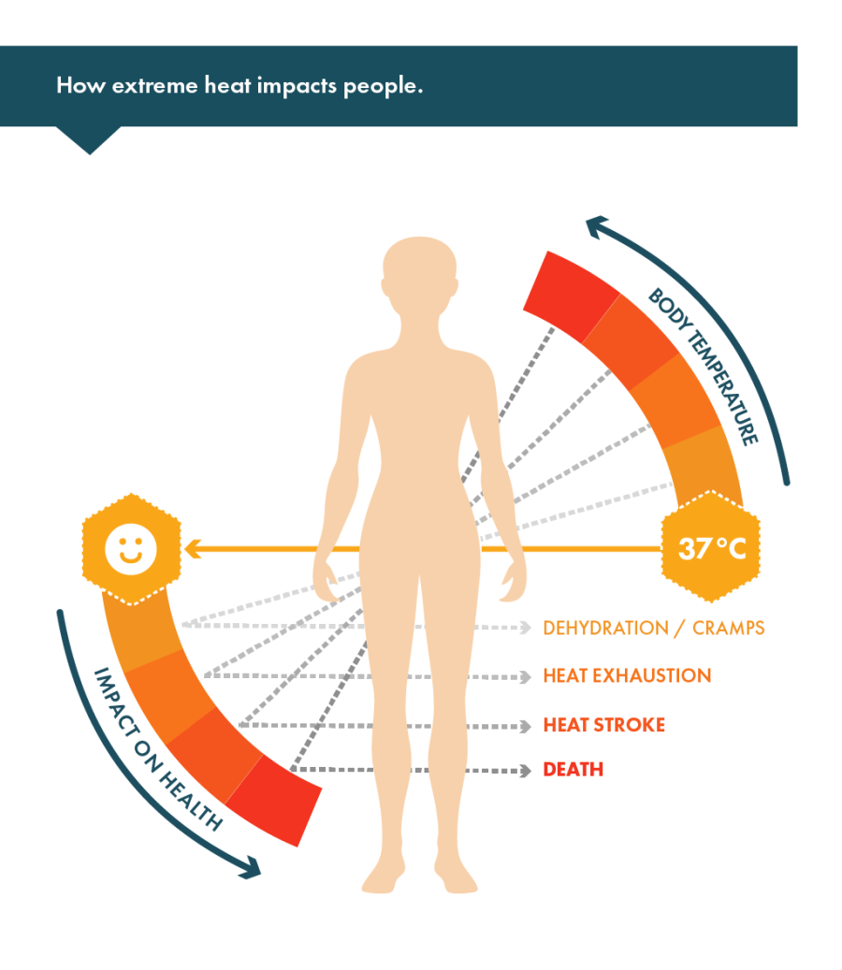
MANDATORY PROVISION
Thermal Comfort (All Climate Zones except Cold Climate)
Buildings in all climate zones except Cold Climate shall comply with following provision of the code:
Maximum Residential Envelope Transmittance Value (RETV) (except the roof) for 4 climate zones namely Composite climate, Hot-dry Climate, Warm-Humid Climate and Temperate Climate shall comply with maximum RETV value of 15 W/m2
Minimum Openable window-to-floor area ratio (WFR _{op}) as follows:
Maximum Thermal Transmittance of roof (U_{roof}) shall comply with maximum U_{roof} value of 1.2 W/m2K.
Image source: Phsc, Link
Climate Type | WFR_{op}
Composite | 12.50
Hot-Dry | 10.00
Warm-Humid | 16.66
Temperate | 12.50
Image source: knaufinsulation, Link
Notes:
Explain the concept of thermal comfort. Brief about the standards of the WFR_{op} to comply based on the climatic zones. - 5 mins

Slide 19
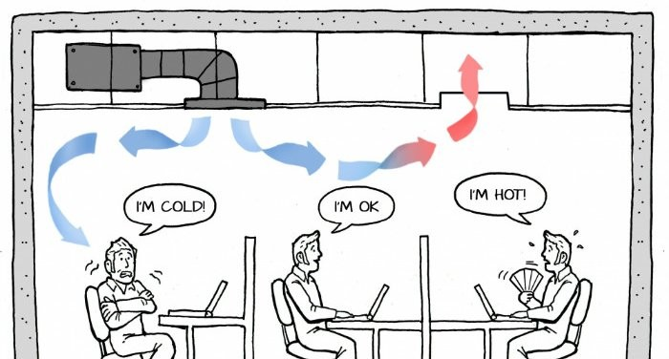
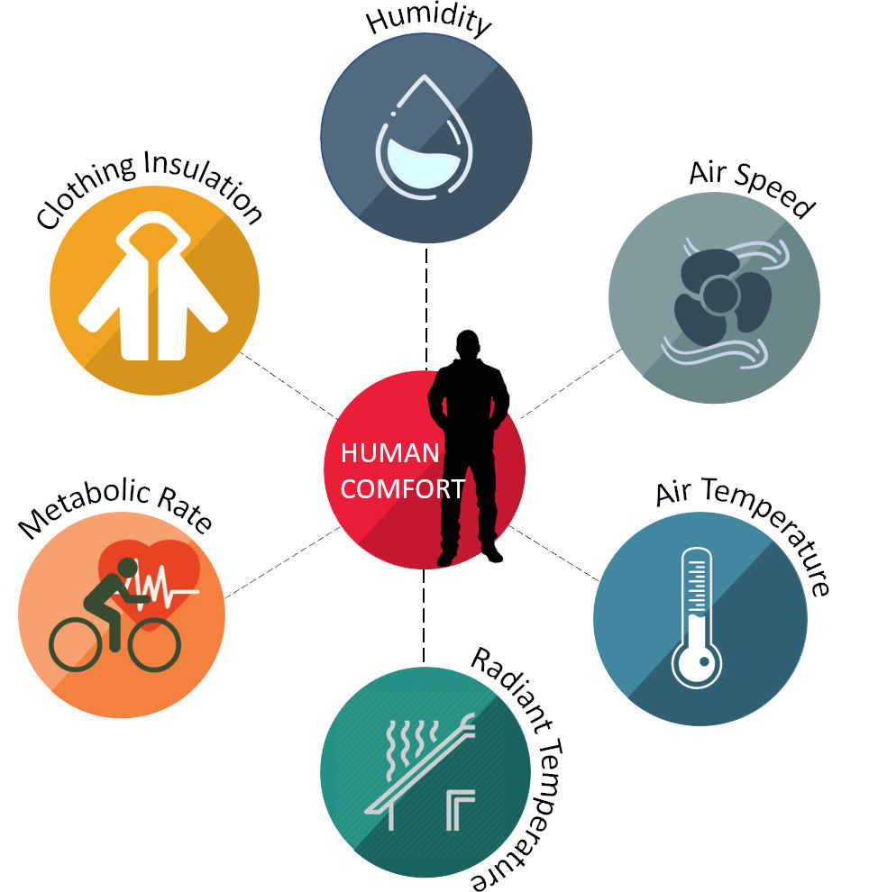
MANDATORY PROVISION
Thermal Comfort (Only Cold Climate)
Buildings in all climate zones except Cold Climate shall comply with following provision of the code:
The thermal transmittance of the building envelope (except the roof) for the cold climate shall comply with the maximum value of 1.8 W/m2K.
Maximum Thermal Transmittance of roof (U_{roof}) shall comply with maximum U_{roof} value of 1.2 W/m2K.
Image source: LinkedIn, Link
Image source:Simulationhub, Link
Notes:
Brief about the minimum requirements of the building envelope for cold climates to maintain the indoor thermal comfort. - 5 mins

Slide 20
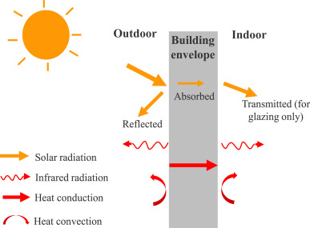
MANDATORY PROVISION
Thermal Comfort
RETV helps to assess how well a building can reduce need for mechanical cooling like air conditioning & ensures thermal comfort indoors with lower energy consumption. Following parameters impacts RETV:
Wall & Roof Materials.
Glazing & Window Properties.
Window-to-Wall Ratio (WWR).
Orientation of Building.
Air Infiltration & Sealing Quality.
Image source: Sciencedirect, Link
Notes:
Explain about RETV and the associated parameters that impacts RETV calculations. - 5 mins

Slide 21
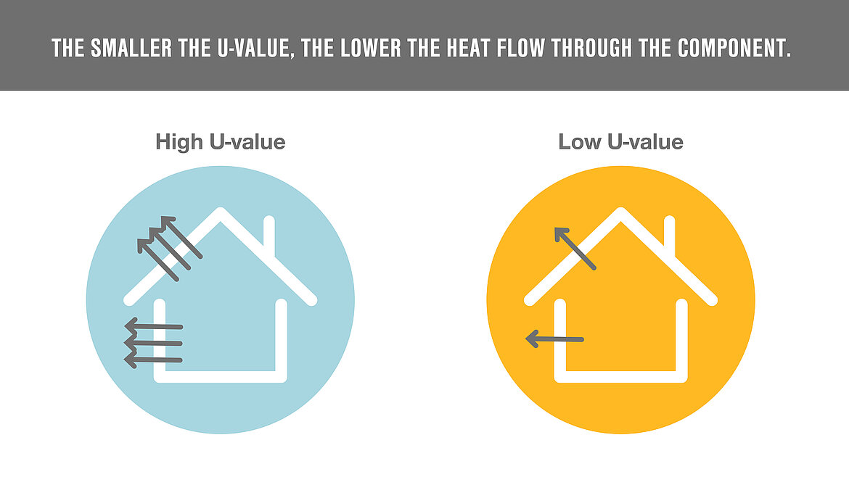
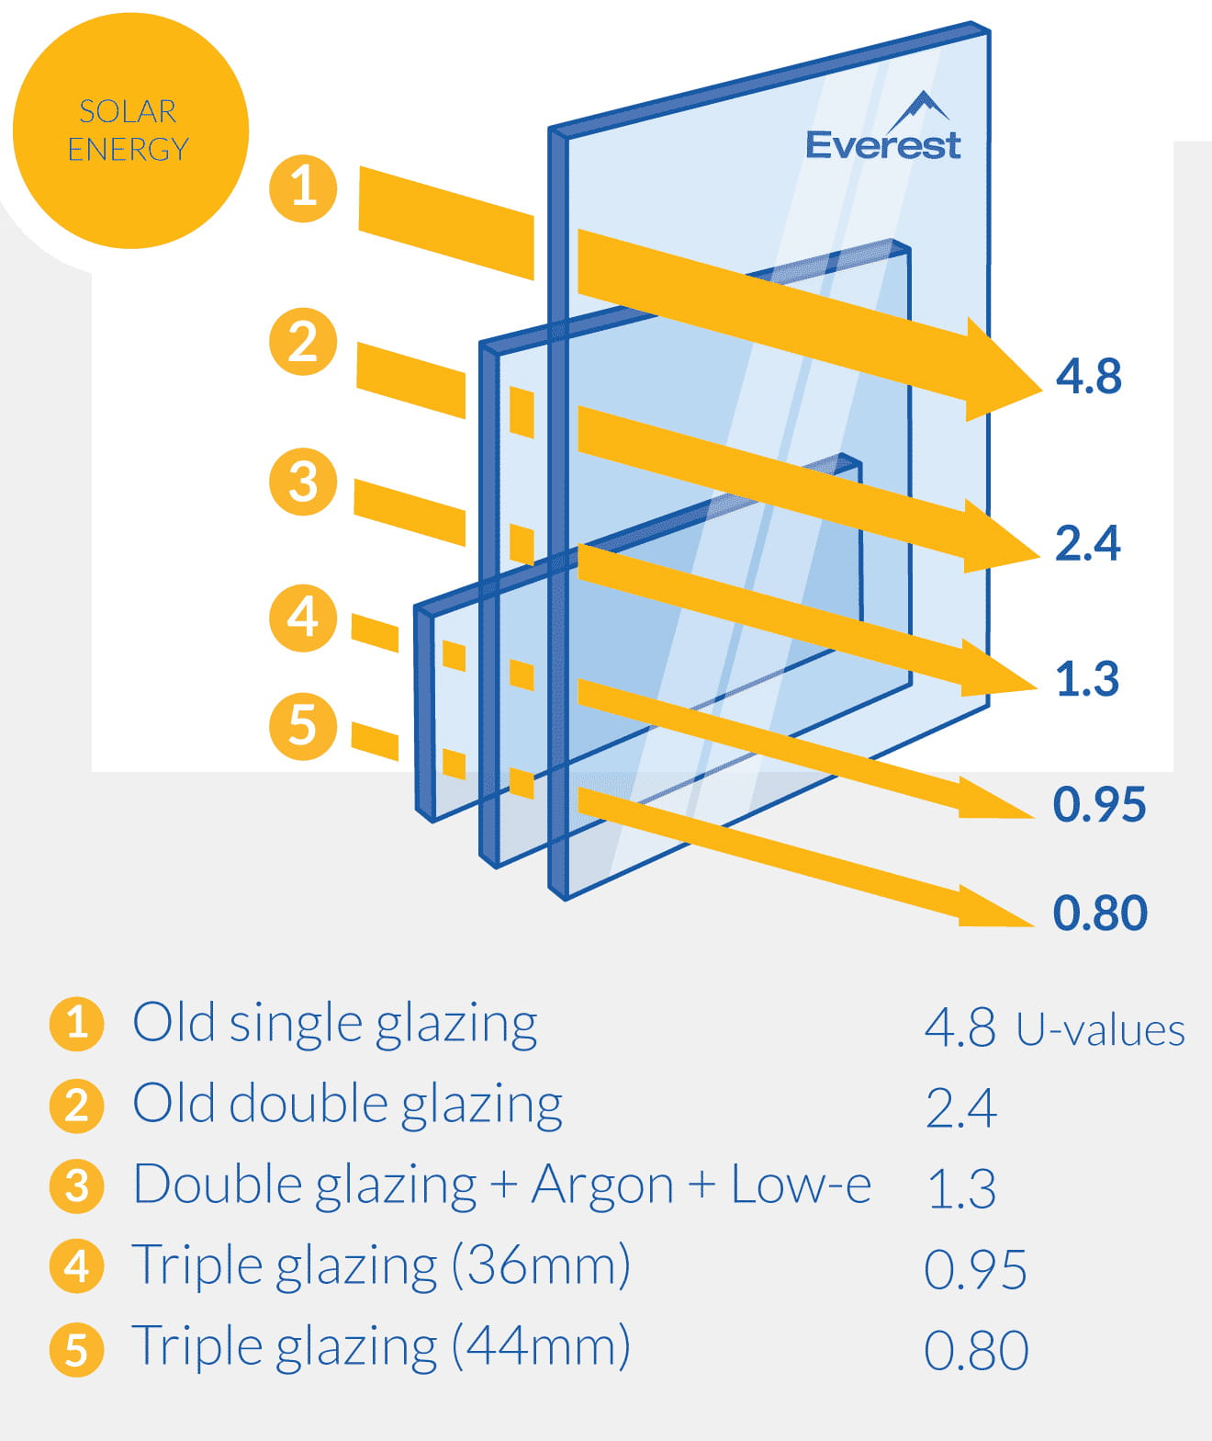
MANDATORY PROVISION
Thermal Comfort
The lower the U Value, the better the material insulates against the heat flow, making it more energy efficient. Its unit is W/m2 K.
Following are U values of some common materials:
Image source: Lamilux, Link
Materials | U Value (W/m2K) | Insulation Performance
Single Glazing | 5-6 | Poor Insulation, High Heat Loss
Double Glazing | 2.5-3 | Moderate Insulation
Brick Wall (Uninsulated) | 1.8-2 | Low Insulation
Brick Wall (Insulated) | 0.3-0.6 | Good Insulation
Roof (Uninsulated) | 1-2 | Poor Insulation
Insulated Roof | 0.1-0.3 | Excellent Insulation
Image source: Everest, Link
Notes:
Explain the concept of thermal transmittance through building envelope with few examples of U-value of materials and its performance. - 5 mins

Slide 22
Air quality in underground parking area
Incremental Points Provision
INCREMENTAL
Points
Cross Ventilation
Daylight Availability
Source: LCES - Author
Notes:
Explain the incremental provisions associated with IEQ module – 3 mins

Slide 23
Cross ventilation
Daylight Availability
Ensuring cross-ventilation in regularly occupied spaces like Kitchen, bedroom, living. dining area with Openable doors, windows or ventilators.
Ensuring above-grade floor areas shall meet the useful daylight illuminance (UDI) area requirements.
SCOPE
Air Quality in underground Car Parking
To install CO sensors to limit CO levels in underground parking areas.
Notes:
Time- 120 Sec
The focus is on preserving the natural features of a construction site during and after development. Buildings should be designed for universal accessibility, catering to individuals with disabilities, the elderly, and children. Efforts should be made to minimize changes to the site's topography and promote landscaped areas. Additionally, measures should be taken to reduce the urban heat island effect by decreasing heat radiation from urban spaces.

Slide 24
FRAMEWORK of INDOOR ENVIRONMENTAL QUALITY – INCREMENTAL POINTS PROVISIONS
Cross Ventilation
Air quality in underground parking area
Daylight Availability
Notes:
Explain the framework of incremental points requirements, and the sections are previously summarized in the slide. – 2 mins

Slide 25
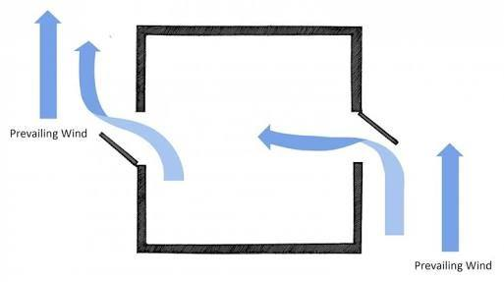
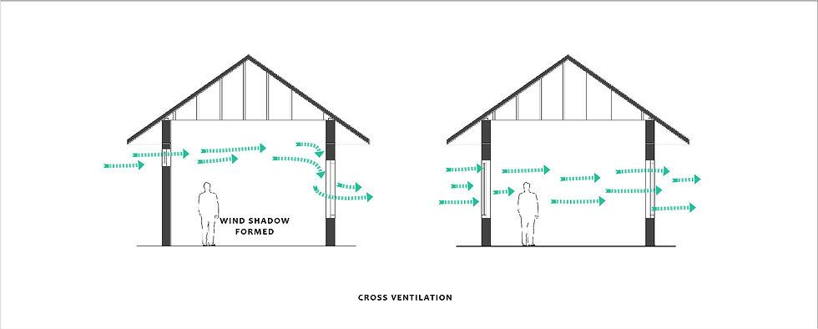
Incremental Points
Cross-ventilation
Cross-ventilation is ensured in regularly occupied spaces (kitchen, bedrooms, living, dining areas) with openable doors, windows, or ventilators. Incremental points are calculated as per the formula below and points as per the table below:
Image source: Designing Buildings, Link
Provision | Incremental Points
50% of regularly occupied spaces have cross-ventilation | 2
75% of regularly occupied spaces have cross-ventilation | 3
90% of regularly occupied spaces have cross-ventilation | 4
Image source: Static, Link
Percentage of cross ventilation area = (cross ventilation Area / total regularly occupied Area) * 100
Notes:
Explain about the concept of the cross ventilation in the building and the method to calculate the area complying for the same. - 5 mins

Slide 26
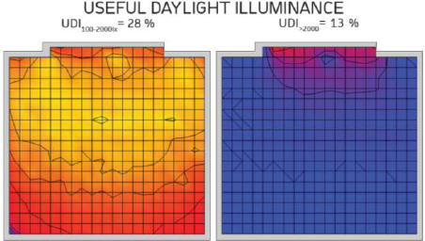
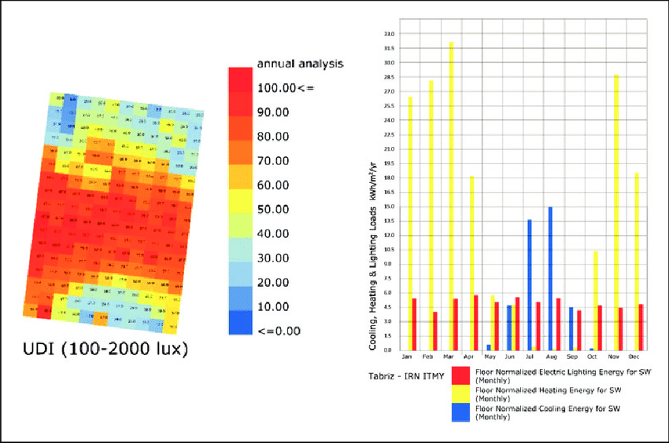
Incremental points
Daylight Availability (Useful Daylight Illuminance)
The building shall comply with the useful daylight illuminance requirement as prescribed by the ECBC 2017, clause no 4.2.3. Ensure above-grade floor areas shall meet or exceed the useful daylight illuminance (UDI) area requirements for 90% of the potential daylit time in a year. Incremental points can be achieved as per table below:
Image source: Researchgate, Link
Provision | Incremental Points
40% of regularly occupied spaces meeting UDI requirement | 2
50% of regularly occupied spaces meeting UDI requirement | 3
60% of regularly occupied spaces meeting UDI requirement | 4
Image source: Researchgate, Link
Software’s used for simulations – Ecotect, IES, Light Stanza etc.
Notes:
Explain about the concept of UDI, its requirement about to meet the compliance as per ECBC 2017 requirements and the points associated with it. - 5 mins

Slide 27
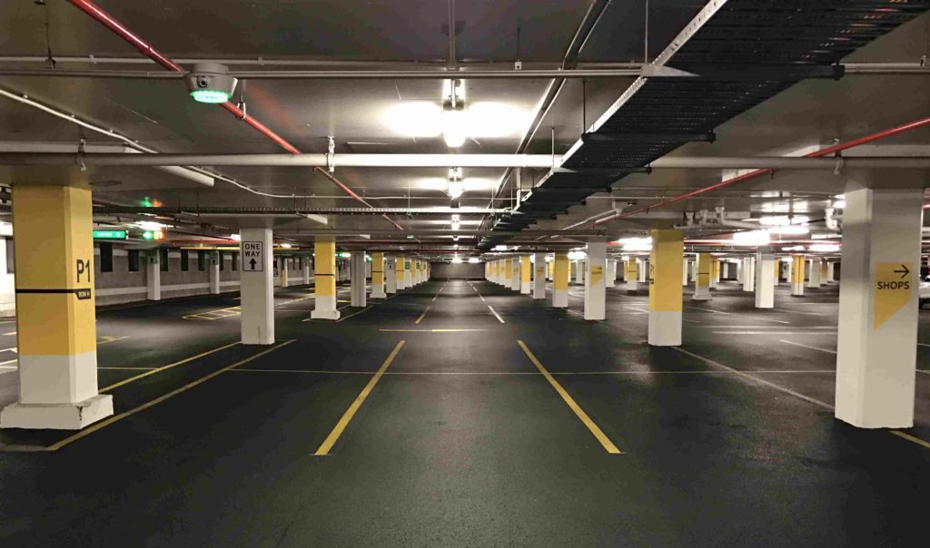
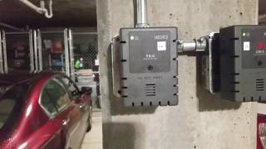
Incremental points
Air Quality in Underground Parking Areas
Image source: Researchgate, Link
Install a demand control ventilation system to limit CO levels in underground parking area to ensure safety and air quality. The location of sensors should be followed as prescribed by NBC 2016, Volume 2, Part 8, Section 3, clause no.11.5.4. Incremental points can be achieved as per table below:
Image source: getmyparking, Link
Provision | Incremental Points
CO Sensors are installed to control the ventilation system to limit CO level | 2
Image source: ytimg, Link
Notes:
Explain about the demand control ventilation system and its relevance to provide CO sensors in the underground parking areas. - 5 mins

Slide 28
SUMMARY
Implementing Strategies that address ventilation, air quality, lighting. Material emissions and thermal comfort ensures a holistic approach to enhancing Indoor Environmental Quality. These measures not only improve occupant health, productivity and well-being but also contribute to sustainable development by reducing energy consumption and creating healthier living environments.
Notes:
Summarized the topics related to IEQ modules – 2 mins

Slide 29
List of required compliance documents
Architectural Floor plans, Section and Elevation Plans with Door-window Schedule.
Technical Datasheets of paints highlighting the VOC content.
Basement Coordinated plan highlighting the ventilation system provided. Technical datasheet of Ventilation system provided for Basement area like Jet, Axial Fan.
Technical datasheet of Glazing system highlighting its technical specifications like VLT, SHGC, U Value.
Technical Datasheet of lighting fixtures highlighting its wattage, lumens, its CRI value.
Details related to Wall and Roof assembly like thickness of wall, roof, insulation provided.
Technical datasheet of CO sensor. Also, photo of display panel of CO sensor.
Notes:
Brief about the documents required to demonstrate the compliance for the mandatory as well as incremental points. - 5 mins

Slide 30
It’s time for a quick knowledge check!
Notes:
Time- 10 Sec

Slide 31
SCAN ME for the quiz!

Slide 32
1. What is the unit of measurement of U-value?
1) W/m2
2) m2/WK
3) W/m2K
4) K/m2W
Notes:
Time- 30 Sec
Ans: 3) FOUR

Slide 33
2. WHAT IS VOC LIMITS FOR FLAT PAINTS?
1) 50 g/L
2) 100 g/L
3) 20 g/L
4) 80 g/L
Notes:
Time- 30 Sec
Ans: 3) FOUR

Slide 34
3. How much of minimum air changes per hour (ACPH) is required for enclosed parking area?
1) 10 ACPH
2) 15 ACPH
3) 5 ACPH
4) 6 ACPH
Notes:
Time- 30 Sec
Ans: 3) FOUR

Slide 35
4. If the VLT value of glass a is 20% and of glass B is 70% which glass is good for daylight penetration?
1) Glass A
2) Glass B
3) Both
4) None of the above
Notes:
Time- 30 Sec
Ans: 3) FOUR

Slide 36
5. Wall 1 (U-value) = 2.6 W/m2K
Wall 2 (U-Value) = 1.7 W/m2K
Room with which wall Type will heat first?
1) Wall 1
2) Wall 2
3) Both
4) None of the above
Notes:
Time- 30 Sec
Ans: 3) FOUR

Slide 37
Let’s see how you scored!
Notes:
Time- 10 Sec

Slide 38
THANK YOU!

