Slide 1
ENS 2024
SUSTAINABLE SITE MANAGEMENT
Prepared by : LCES
Created Jan 2025
Notes:
Time- 45 Sec
The Eco Niwas Samhita is a set of guidelines focused on sustainable residential building practices in India.
The code got amended in 2024 with sustainable practices and it is also called ECSBC for residential buildings .

Slide 2
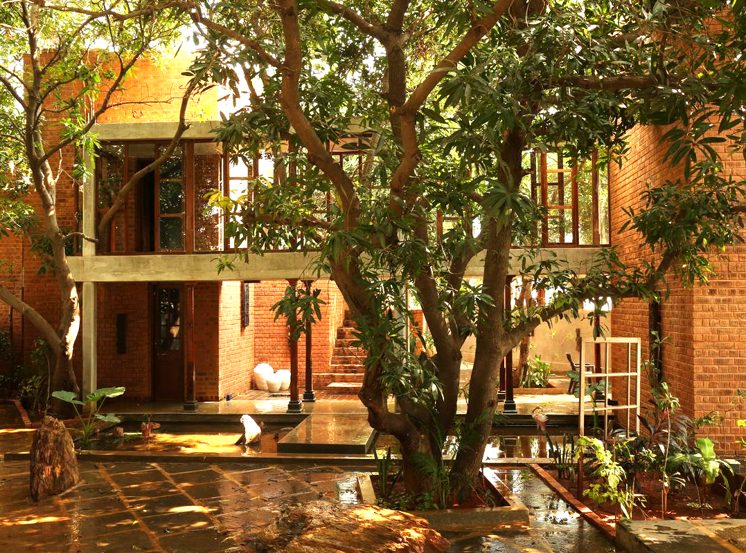
SUSTAINABLE SITE MANAGEMENT
Objective
To minimize the impact of construction activity on the natural terrain and topography of the site during the construction phase in Residential buildings.
Image source: The Hindu, Link
Notes:
Time- 30 Sec
Slide is self explanatory.

Slide 3
Site Preservation
Universal accessibility
Maintaining and enhancing the natural characteristics of a site during and after construction.
Buildings are designed and constructed to be accessible and usable by everyone, including people with disabilities, the elderly, and children.
SCOPE
landscaping
Mitigating urban heat island
Minimizing disturbances to the topography & gradient of the site by retaining natural features of the site and developing vegetated landscaped spaces.
Mitigating the urban heat island effect involves reducing the amount of heat that radiates from urban areas.
Notes:
Time- 120 Sec
The focus is on preserving the natural features of a construction site during and after development. Buildings should be designed for universal accessibility, catering to individuals with disabilities, the elderly, and children. Efforts should be made to minimize changes to the site's topography and promote landscaped areas. Additionally, measures should be taken to reduce the urban heat island effect by decreasing heat radiation from urban spaces.

Slide 4
FRAMEWORK of sustainable site management
Site Preservation
Universal Accessibility
Landscaping
Urban Heat Island
Mandatory Provisions
Mandatory Provisions
Mandatory Provisions
Mandatory Provisions
Incremental Provisions
Incremental Provisions
Notes:
Time- 60 Sec
4 main criteria's
All 4 mandatory (which must be fulfilled for compliance).
And only 2 has incremental provisions

Slide 5
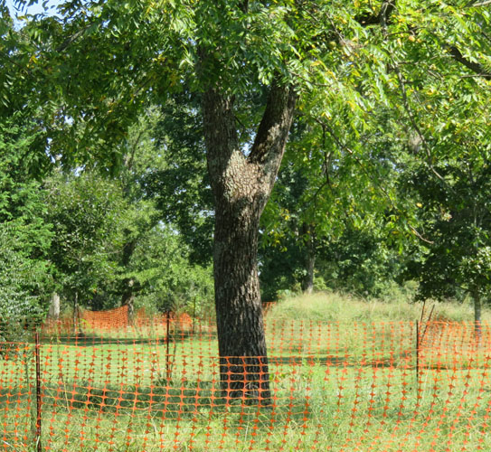
Mandatory requirement
Site Preservation
To protect or preserve existing mature trees naturally.
Else, compensatory Plantation for felled/transplanted trees in the ratio 1:3 to be ensured.
Preservation of Topsoil (150-200mm) & reuse of the same for landscaping.
The stored topsoil shall be used as finished grade for planting areas.
Construction shall not hinder existing areas like water bodies, power or communication lines, sewerage lines that are located on or adjacent to the project site.
Image source [From Left to Right]
1. Consultree, Link, 2. Maryville University, Link, 3.Shaili Contractor, Link
Notes:
Time- 120 Sec
Preserve Existing trees or compensatory plantation for felled/transplanted trees in 1:3 ratio.
Preserve & reuse Topsoil
Preserve water bodies and other MEP service lines passing through the plot.

Slide 6
Mandatory requirement
Universal Accessibility
What is Universal Accessibility?
It is to make buildings and other environments accessible to as many people as possible, regardless of their age, size, disability, or other factors.
Image source: Behance, Link
Notes:
Time- 45 Sec
Slide is self explanatory.

Slide 7
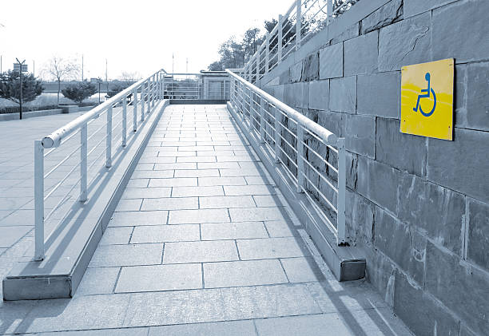
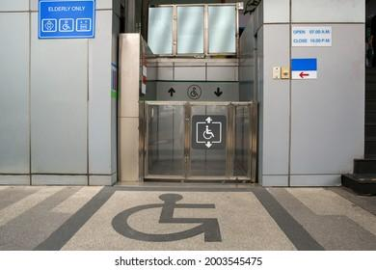
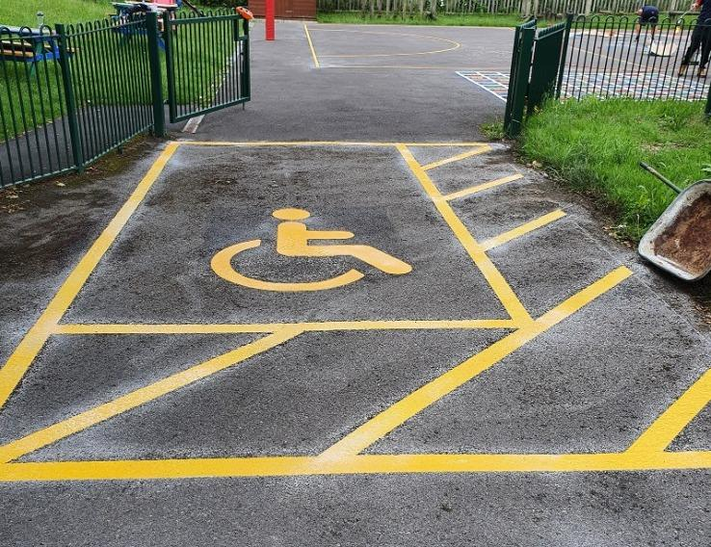
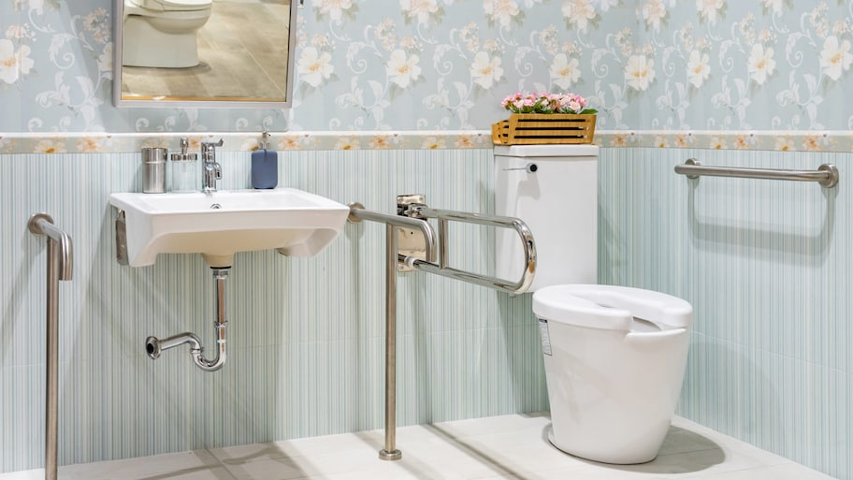
Mandatory requirement
Universal Accessibility
Residential buildings shall be universally accessible with special provisions for children, the elderly and differently abled people in accordance with Chapter 8 of the Model Building Bylaws, 2016 (Source: MoHUA, Model Bye-Laws - 2016, Link )
Image source [From Left to Right]
iStock, Link, 2.Shutterstock, Link, 3.Jess Sparks, Link, 4.Angi, Link
Notes:
Time- 90 Sec
Chapter 8 of the Model Building Bylaws, 2016- PROVISIONS FOR DIFFERNTLY-ABLED, ELDERLY AND CHILDREN
Points to be considered while designing as per bylaws-
Site development – Access Path / Walk Way, Parking
Building requirements- Approach to plinth level, Corridor connecting the entrance/ exit for the differently abled, Stair-ways, Lifts, Toilets, Designing for Children, Drinking Water, Refuge, Proper signage.

Slide 8
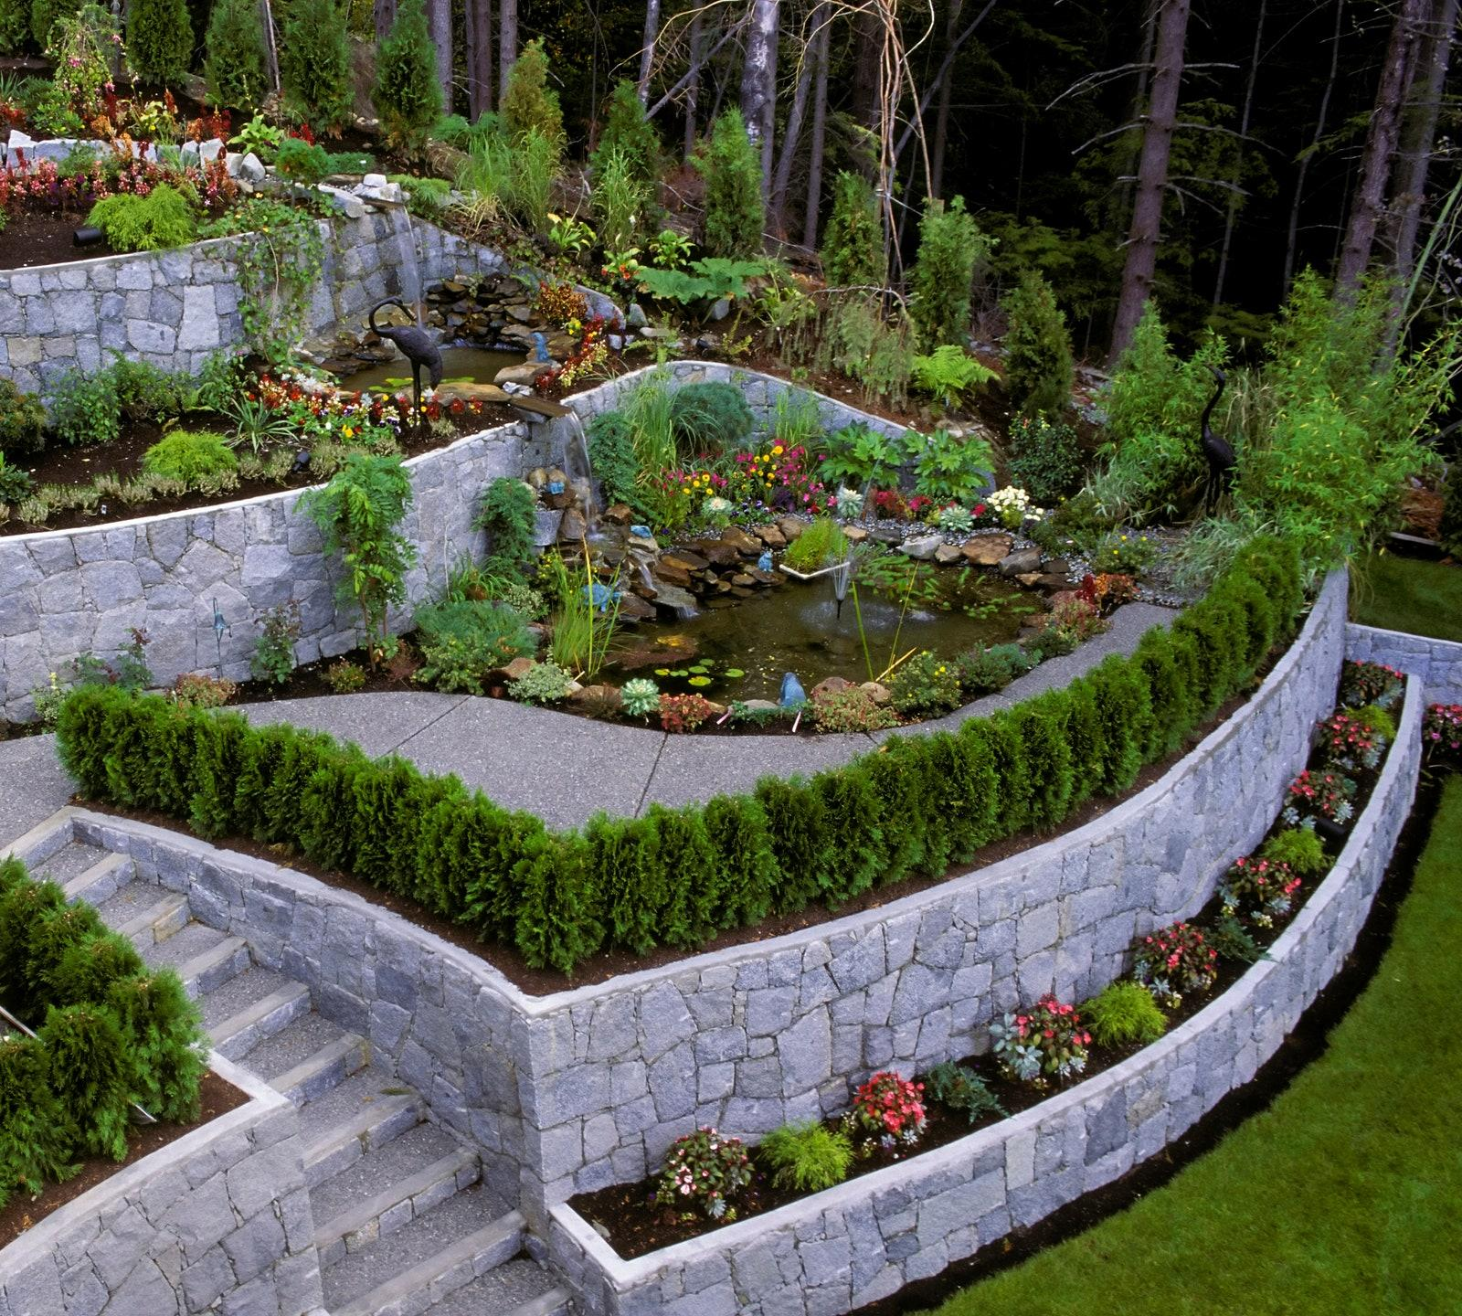
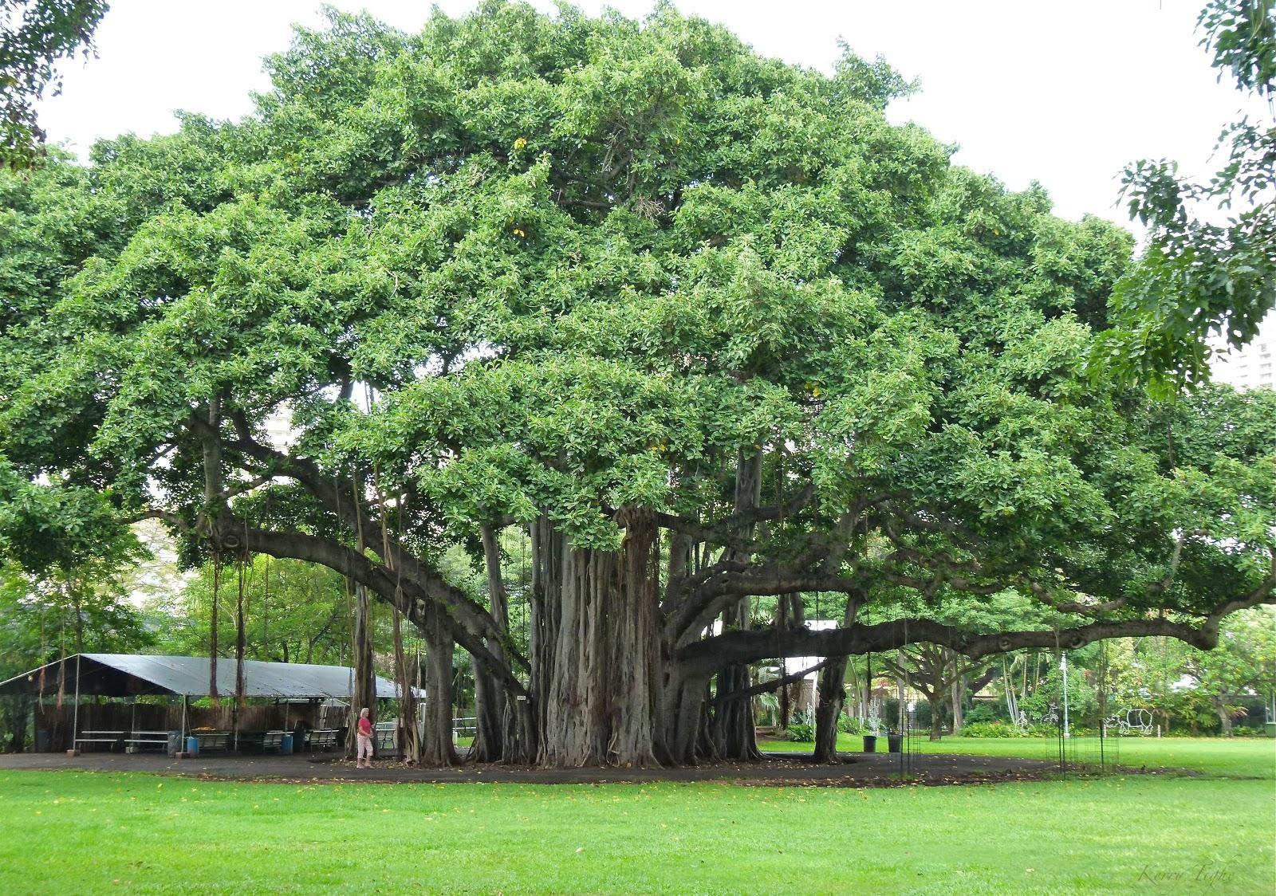
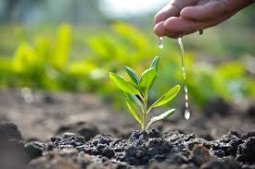
Mandatory requirement
Landscaping
Minimize disturbances to the topography & gradient of the site and develop vegetated landscape for min. 20% of total landscape.
Turf to be limited for no more than 30% of the total landscaped area.
A minimum of 30% of the landscaped area must be planted with native/adaptive species of plants/trees.
Plantation shall be as per Section 8 of the Urban Greening Guidelines, 2014 (Source: MoHUA, Urban Greening Guidelines- 2014, Link ).
A min. 1 tree /80 sqm. of land should be planted and maintained to ensure at least 10% of plot area under tree cover.
Compensatory Plantation for felled/transplanted trees in the ratio 1:3 within the premises.
Image source [From Left to Right]
1.Architectural digest, Link, 2.Ozbreed, Link, 3.Artipalego, Link, 4.iStock, Link
Notes:
Time- 120 Sec
Section 8 of the Urban Greening Guidelines, 2014*.- Policy Guidelines for strengthening Urban Greens
Points listed in the guidelines-
Criteria for Plantation along the Roads & types of planting- Avenue Planting, Group Planting, Mixed Planting, Informal Planting
Spacing of trees-
Trees which provide thick cover
Trees Unsuitable for Roadside Avenues
Thorny Trees
Plantation for water logged areas
Plantation for Sandy Areas
Plantation for Wooded Areas
Plantation for Industrial areas
Plantation for Parking areas

Slide 9
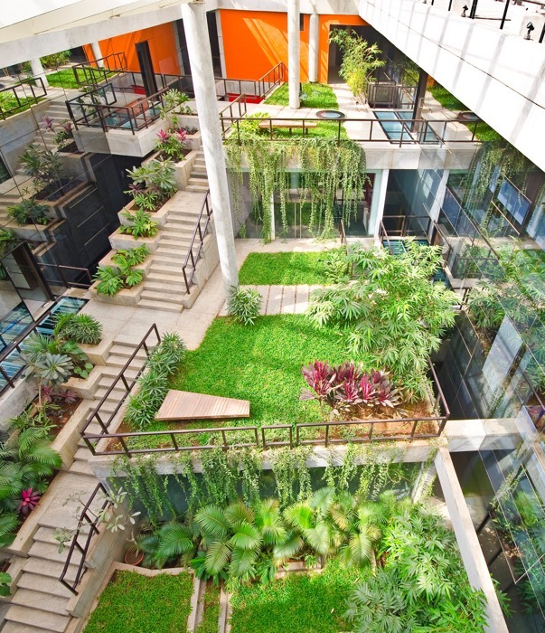
Incremental Provisions
LANDSCAPING
Points for increasing vegetated area on site
S.No. | Minimum Vegetated Area | Incremental Point
1 | 30% of total landscape area | 6
2 | 40% of total landscape area | 8
Points for Reducing the Turf area
S.No. | Maximum turf Area | Incremental Point
1 | 20% of total landscape area | 2
2 | 15% of total landscape area | 4
Points for increasing the landscape area planted with native plant species
S.No. | Minimum area with Native plant species | Incremental Point
1 | 40% of total landscape area | 2
2 | 50% of total landscape area | 4
Image source: Design pataki, Link
Notes:
Time- 60 Sec
Slide is self explanatory.

Slide 10
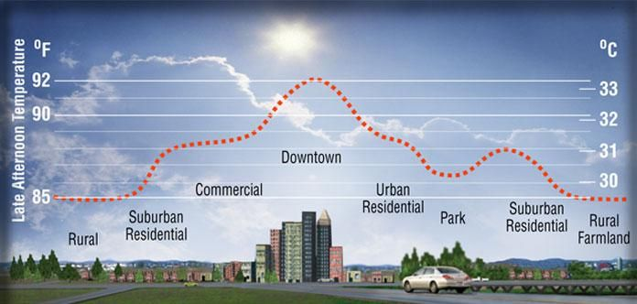
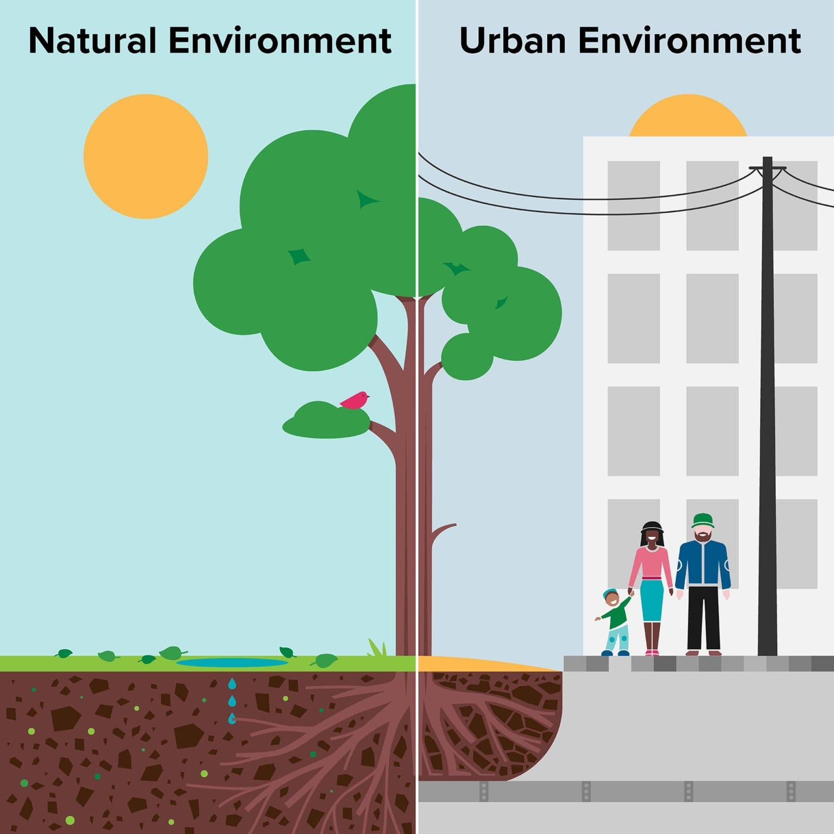
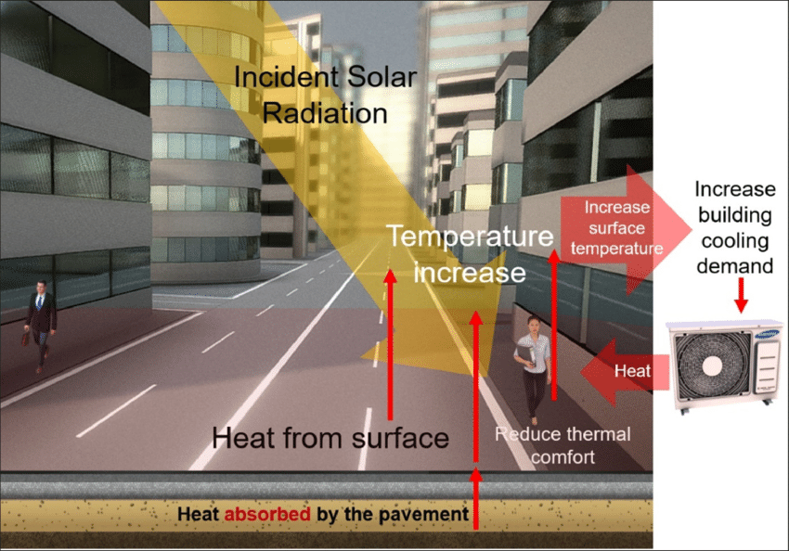
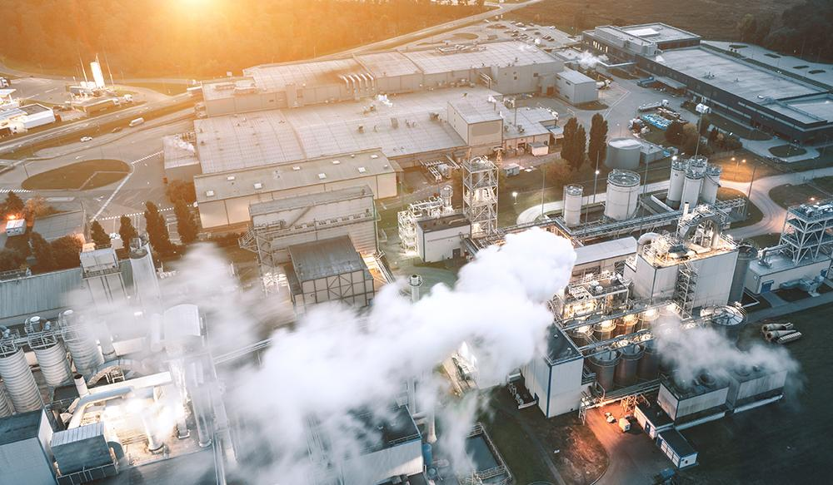
Mandatory requirement
Mitigating Urban Heat Island
What is Urban Heat Island Effect?
A phenomenon where urban areas experience significantly higher temperatures compared to their surrounding rural areas.
This gap in temperature is mainly due to human actions and the distinct features of man-made surroundings.
Image source: Pinterest, Link
Causes of Urban Heat Island
Lack of vegetation- fewer trees, parks, and green spaces, which absorb and store less heat.
Materials & surfaces- Paved surfaces, buildings, and other infrastructure in cities absorb and retain more heat.
Human activities- transportation, industrial processes, and air conditioning release excess heat into the urban environment.
Notes:
Time- 120 Sec
Slide is self explanatory.

Slide 11
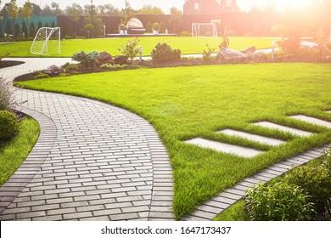
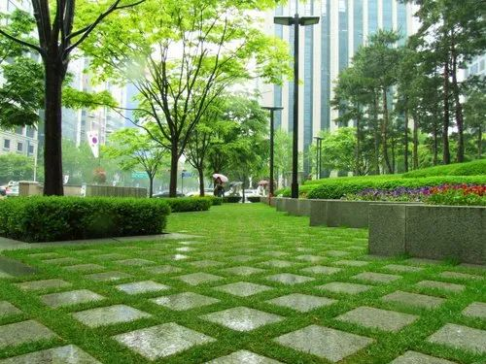
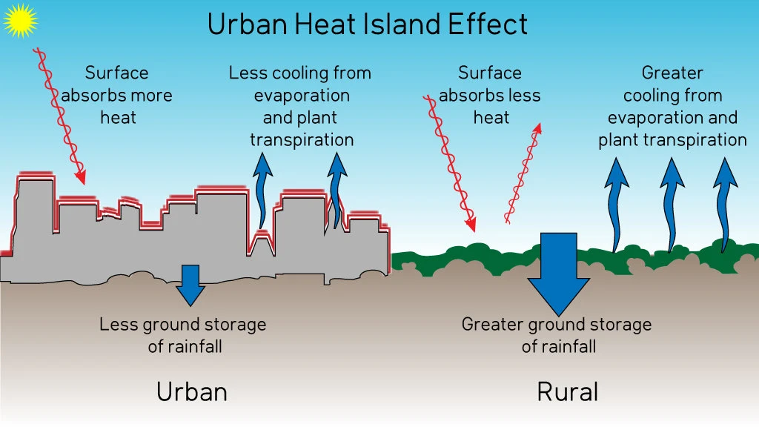
Mandatory requirement
Mitigating Urban Heat Island
Limiting the net paved area of the site under parking, roads, paths, or any other use so as not to exceed 25% of the site area.
More than 50% of the total paved area shall have pervious paving/grass pavers/open grid pavements.
Image source: S.Avinash, Link
Image source [From Left to Right]
Architecturaldigest, Link, 2.Indiamart, Link,
Notes:
Time- 45 Sec
Slide is self explanatory.

Slide 12
Incremental provisions
MITIGATION OF URBAN HEAT ISLAND
Points for reducing paved area on site
S.No. | Maximum net paved area on site | Incremental Point
1 | Up to 20% of the site area | 4
2 | Up to 15% of the site area | 6
Points for increasing pervious paving
S.No. | Minimum Pervious Paving | Incremental Point
1 | 60% of the total paved area | 5
2 | 70% of the total paved area | 8
Image source: Wordpress, Link
Notes:
Time- 45 Sec
Slide is self explanatory.

Slide 13
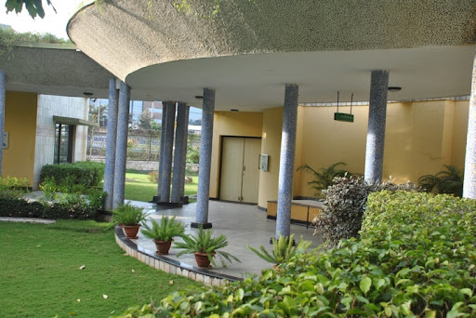
summary
Sustainable site management involves practices that minimize environmental impact, conserve resources, and promote ecological balance during the construction and operation of a site.
Below are key strategies for its compliance:
Site Preservation (Mandatory)
Universal Accessibility (Mandatory)
Landscaping (Mandatory + Incremental)
Mitigating Urban Heat Island (Mandatory + Incremental)
Image source: CII GBC, Link
Notes:
Time- 60 Sec
Slide is self explanatory.

Slide 14
List of required compliance documents
Site Plan highlighted trees (existing mature trees, preserved trees, transplanted, removed), along with highlighting top soil excavation and top soil storage and preservation area with volume.
Fertility report of soil from a certified lab.
Survey-plan highlighted existing features of the site like existing water bodies, power or communication lines, sewerage lines.
Accessibility Plan highlighted measures (ramps with handrails on entrances and grade change, tactile guiding system, easily accessible play areas etc.) to ensure universal accessibility including features for differently abled, children and elderly.
Landscape Plan highlighted the following:
Plant/tree schedule for all vegetated species being planted along with measures taken to preserve local biodiversity and ecology;
All type of finishes used on site with legend
Waterbodies/ water features, Vegetated areas, paved areas, building footprint.
Notes:
Time- 120 Sec
Slide is self explanatory.

Slide 15
It’s time for a quick knowledge check!
Notes:
Time- 10 Sec

Slide 16
SCAN ME for the quiz!
Notes:
Time- 45 Sec

Slide 17
1. How many Mandatory requirements are there in Sustainable site module?
1) THREE
2) TWO
3) FOUR
4) NO MANDATORY REQUIREMENT
Notes:
Time- 30 Sec
Ans: 3) FOUR

Slide 18
2. How much depth of top soil to be preserved?
1) 50-100 mm
2) 50-200 mm
3) 150-200 mm
4) 200-300 mm
Notes:
Time- 30 Sec
Ans: 3) 150-200 mm

Slide 19
3. Universal accessibility to be designed as per?
1) Chapter 8 of the National Building code.
2) Chapter 9 of the National Building code.
3) Chapter 9 of the Model Building Bylaws, 2016.
4) Chapter 8 of the Model Building Bylaws, 2016.
Notes:
Time- 30 Sec
Ans: 4) Chapter 8 of the Model Building Bylaws, 2016.

Slide 20
4. What is the mandatory requirement for tree plantation?
1) 1 Tree/80 sq.m.
2) 1 Tree/100 sq.m.
3) 1 Tree/50 sq.ft.
4) 1 Tree/100 sq.ft.
Notes:
Time- 30 Sec
Ans: 1) 1 Tree/80 sq.m.

Slide 21
5. What is the mandatory requirement for mitigating urban heat island?
1) Net paved area <25% of the site area & 50% of the paved area shall have pervious paving.
2) Net paved area <50% of the site area & > 25% of the paved area shall have pervious paving.
Notes:
Time- 30 Sec
Ans: 1) Net paved area <25% of the site area &
50% of the paved area shall have pervious paving.

Slide 22
Let’s see how you scored!
Notes:
Time- 10 Sec

Slide 23
THANK YOU!

