Slide 1
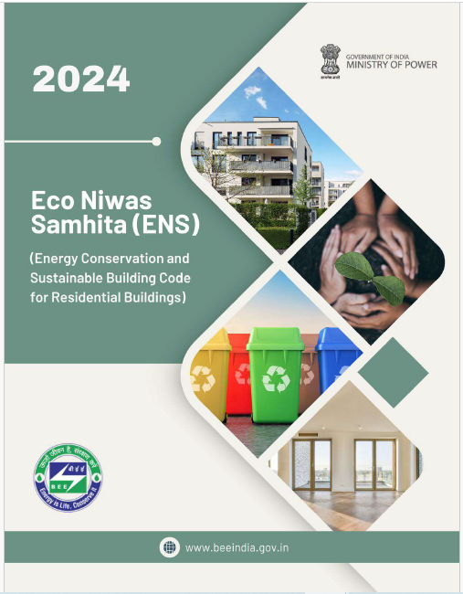
ENS 2024
Waste Management
Prepared by : LCES
Created Jan 2025
Notes:
Time- 45 Sec
The Eco Niwas Samhita is a set of guidelines focused on sustainable residential building practices in India.
The code got amended in 2024 with sustainable practices and it is also called ECSBC for residential buildings .

Slide 2
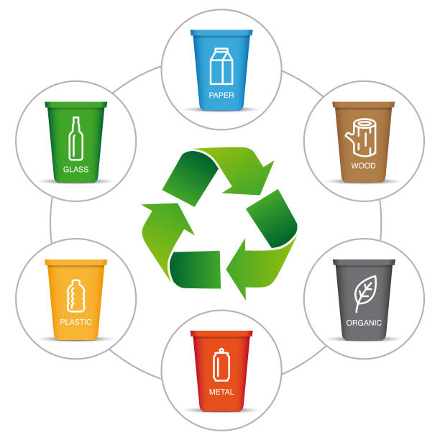
Waste Management
Objective
Effective waste management minimizes the waste generated, directing it away from landfills and promoting recycling and reuse.
Our goal is to create cleaner, healthier, and more sustainable communities through efficient waste management strategies
Image source: Certifieswastesolutions, Link
Notes:
Time : 30 Sec
Importance of waste management to be explained.

Slide 3
Scope of waste management
This section discusses the scope of waste management within a construction project, emphasizing the importance of minimizing waste at both the construction and post-occupancy stages.
Notes:
Time : 30 Sec
Slide is self explanatory.

Slide 4
FRAMEWORK of sustainable Waste management
Waste Management
Mandatory Provisions
Incremental Provisions
Construction Waste Management
Post Construction Waste Management
Construction Waste Management
Post Construction Waste Management
Notes:
Time : 60 Sec
Explains the main categories addressed in the module along with mandatory and incremental categories.

Slide 5
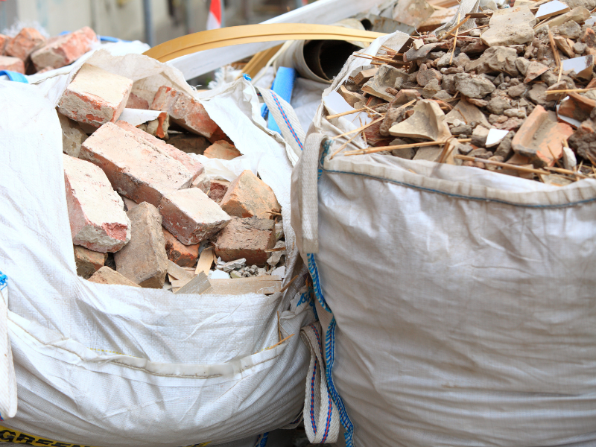
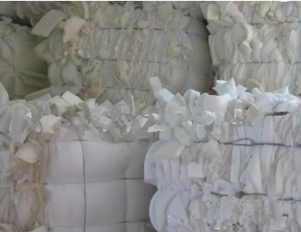
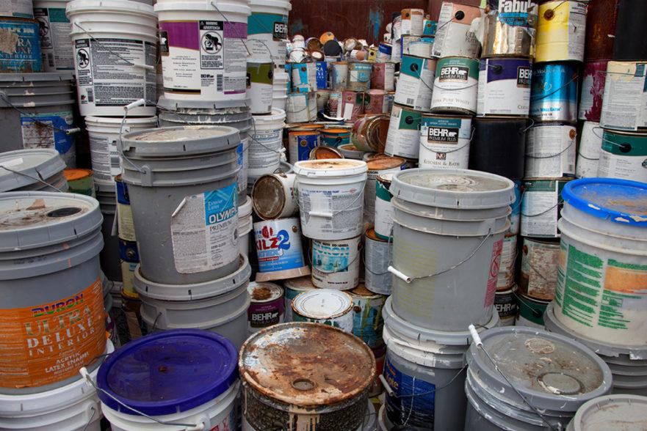
Classification of Construction Waste
1. Non-Hazardous Waste: Metals, wood, masonry, etc
2. Packaging Waste: Plastic wrapping, foam, crates, and other materials used in packaging.
3. Hazardous Waste: Lead, adhesives, broken glass, etc., requiring special disposal measures.
Image source: From Left to Right
1.Wellingtonwaste, Link, 2. Tradeindia, Link, 3. Maratek, Link
Notes:
Time : 45 Sec
Slide talks about types of waste generated during the construction phase.
Content is self explanatory.

Slide 6
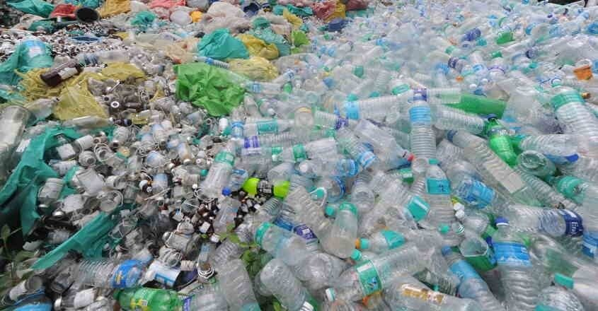
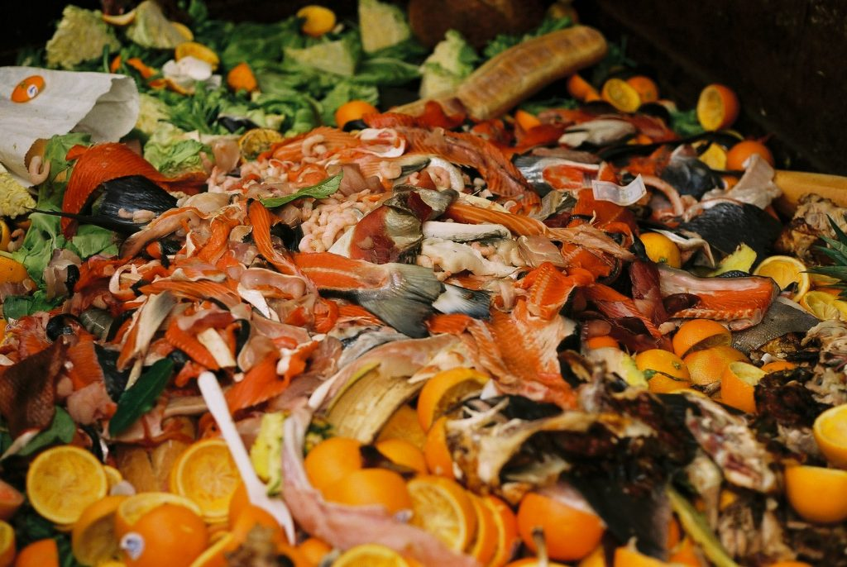
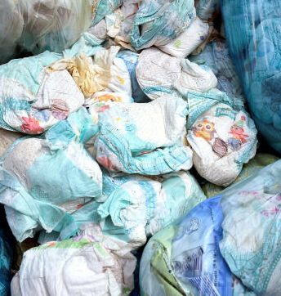
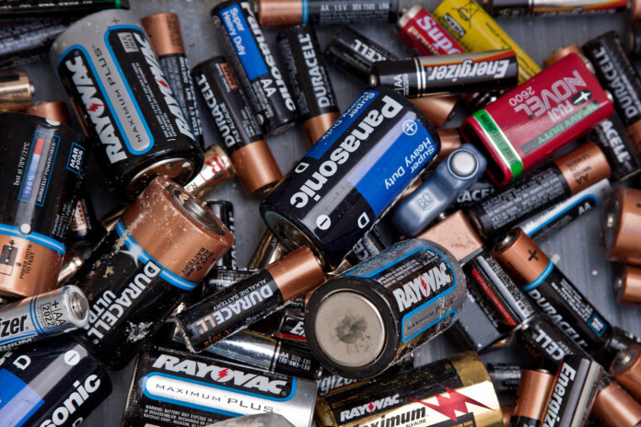
Classification of Post-Occupancy Waste
1. Dry Waste: Plastics, paper, electronics, metals, etc.
2. Wet Waste: Organic waste such as food and horticulture waste.
3. Sanitary Waste: Diapers, sanitary pads, masks, etc.
4. Hazardous Waste: Chemical containers, batteries, syringes.
Image source: From Left to Right
1.Omamanorama, Link, 2. Analyticsindiamag, Link, 3. Lemonde, Link , 4.Sustainabilitynext, Link
Notes:
Time : 45 Sec
Slide talks about types of waste generated during post-occupancy.
Content is self explanatory.

Slide 7
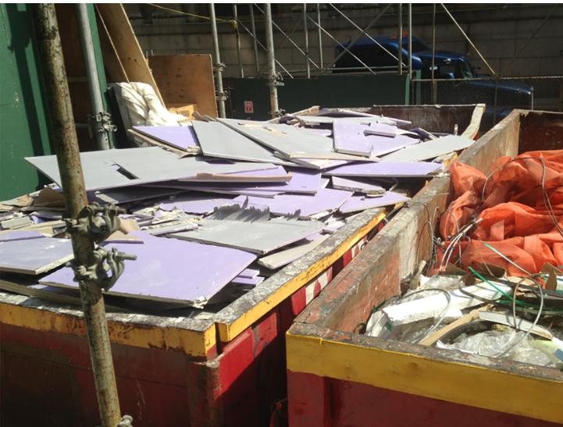
Mandatory requirement
Construction Management
SEGREGATION AND STORAGE OF WASTE
Designated areas shall be provided within the site/ neighboring site for collection, segregation, and storage of segregated waste as mentioned in the classification of Construction Waste.
Image source: Zerowastedesign, Link
Notes:
Time : 45 Sec
Waste generated during the construction are classified into Non-hazardous waste, packaging waste and Hazardous waste.
Designated area should be provided for each classification of waste within the site/adjacent site for collection, segregation & storage to be taken care for Code compliance

Slide 8
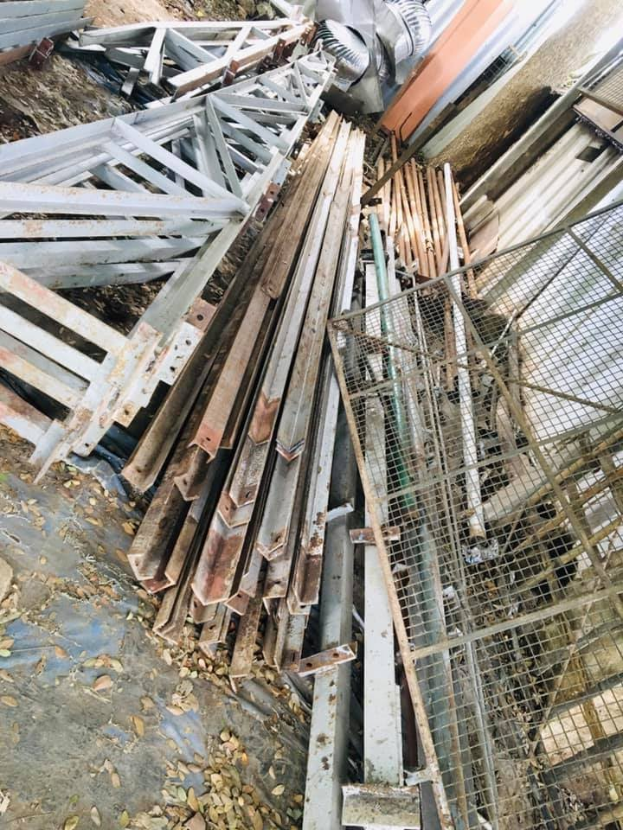
Mandatory requirement
Construction Management
MINIMIZATION OF NON HAZARDOUS WASTE
Non-hazardous waste, such as metals and masonry materials, should be minimized and reused.
At least 50% of the non-hazardous waste generated during construction should be repurposed or recycled. This helps reduce landfill contribution and saves on resources.
Image source: Facebook, Link
Notes:
Time : 45 Sec
Some types of construction waste can be reused/repurposed on-site as fill material for levelling uneven terrain, filling excavated areas, or creating embankments, as a base or subbase material for road construction, for erosion control measures, constructing retaining walls, as bedding and backfill material for utility pipelines, etc

Slide 9
Incremental Provisions
MINIMIZATION OF NON-HAZARDOUS WASTE
Non-hazardous construction waste generated shall have to be reused/ repurposed/ recycled/ salvaged, to comply with the requirements as per below Table.
Provision | Incremental Points
75% of non-hazardous waste generated is reused/ repurposed/ recycled/ salvaged | 1
95% of non-hazardous waste generated is reused/ repurposed/ recycled/ salvaged | 2
Notes:
Time : 30 Sec
Slide is self explanatory.

Slide 10
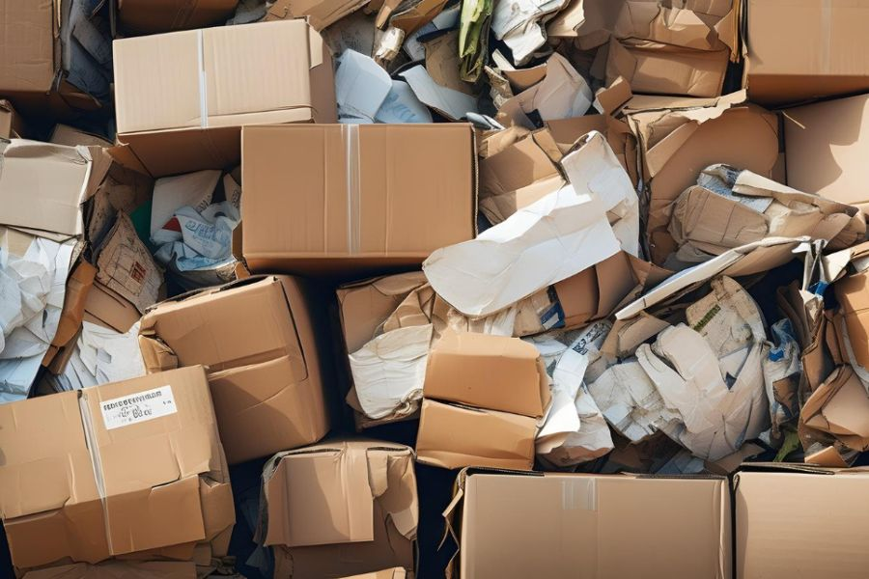
Mandatory requirement
Construction Management
Recycling of Packaging Waste
Packaging waste such as cardboard, plastic wrap, and foam should be sent for recycling.
100% of packaging recyclable waste must be handed over to authorized recyclers or municipalities to ensure safe disposal.
Image source: Paramountglobal, Link
Notes:
Time : 45 Sec
Slide is self explanatory.

Slide 11
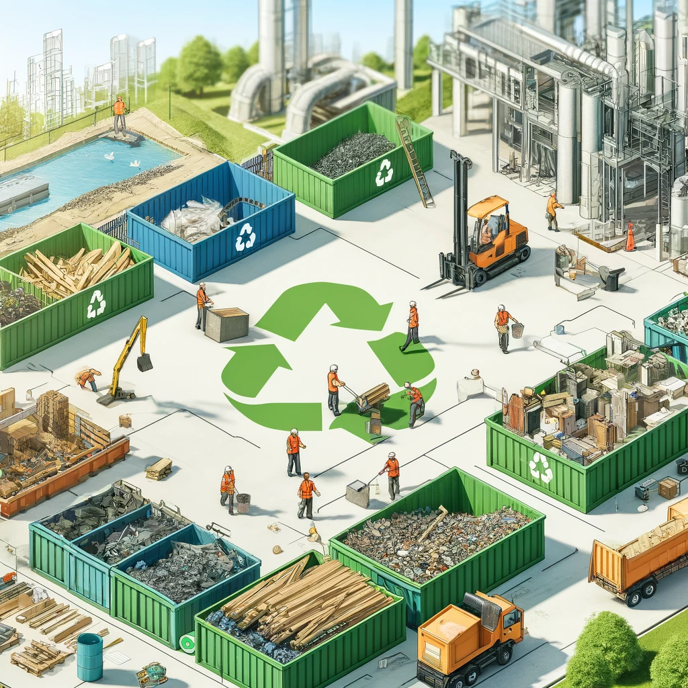
Mandatory requirement
Construction Management
Divert Construction Waste from the Landfill
Ensure that all (100%) the construction waste (by either weight or volume) generated during the construction process is either reused/repurposed/salvaged on-site, diverted to recycling facilities, or safely handed over to municipalities.
Diversion efforts shall be tracked throughout the construction process.
Image source: Siteservicesusa, Link
Notes:
Time : 45 Sec
Slide is self explanatory.

Slide 12
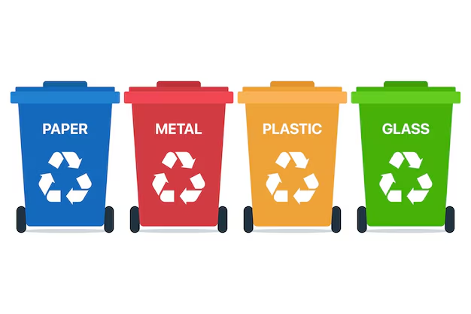
Mandatory requirement
Post - Construction Management
Waste collection, Segregation & Storage
Post-construction, waste management protocols must be in place to collect, segregate, and store all types of waste.
A designated centralized waste collection unit should be established with at least four colour-coded bins for dry waste, Organic waste, sanitary, and hazardous waste E-waste.
Image source: Freepik, Link
Notes:
Time : 120 Sec
A daily waste collection schedule should be developed to collect the segregated waste from each building and store at a designated centralized storage area in the premises until its transportation to respective recyclers.
Dry, sanitary, and hazardous waste shall be transported to/ collected by authorized recyclers/ Municipal Corporation.

Slide 13
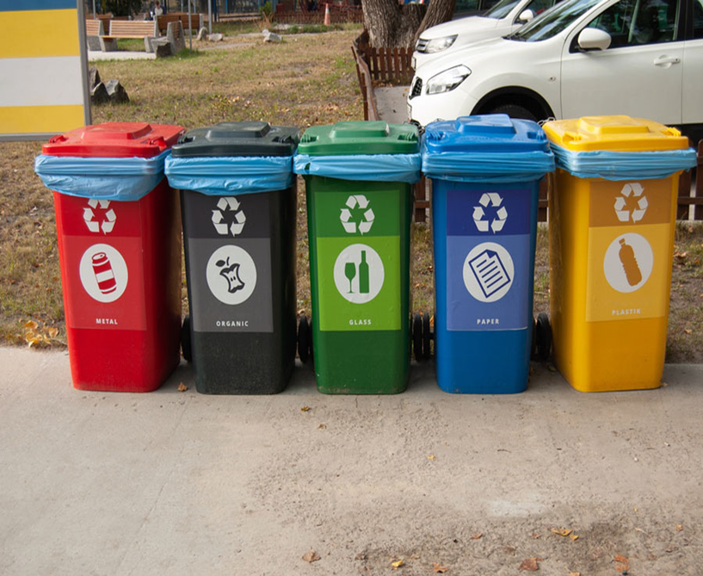
Incremental Provisions
WASTE COLLECTION, SEGREGATION AND STORAGE
Different categories (organic, sanitary, Hazardous, plastic, paper, glass, metal, packaging, E-waste) of colour-coded waste collection bins are provided for waste segregation in the centralized waste collection area, as per Table.
Image source: Kolkata Municipal Corporation, Link
Provision | Incremental Points
100% of recyclable waste shall be segregated into six categories. | 1
100% of recyclable waste shall be segregated into eight categories. | 2
Notes:
Time : 30 Sec
Slide is self explanatory.

Slide 14
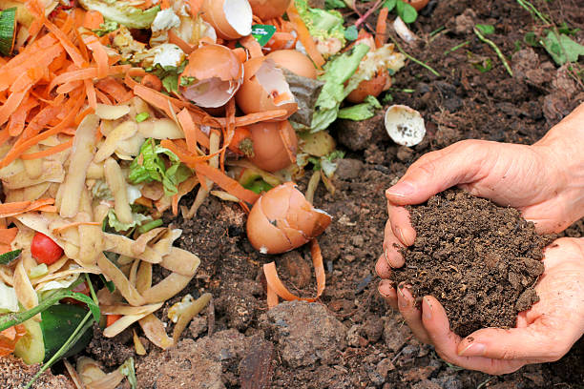
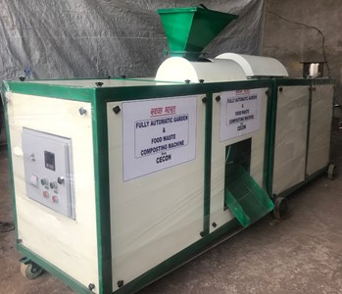
Mandatory requirement
Post - Construction Management
Organic Waste Treatment
For projects with a built-up area of 5000 m2 or more, an onsite designated area shall be provided to compost (manually or mechanically) at least 50% of the organic waste must be treated onsite through composting methods.
Smaller projects can opt to hand over the organic waste to municipal facilities if composting on site is not feasible.
Organic waste
Organic waste Composter
Image source: iStock, Link
Notes:
Time : 60 Sec
Slide is self explanatory.

Slide 15
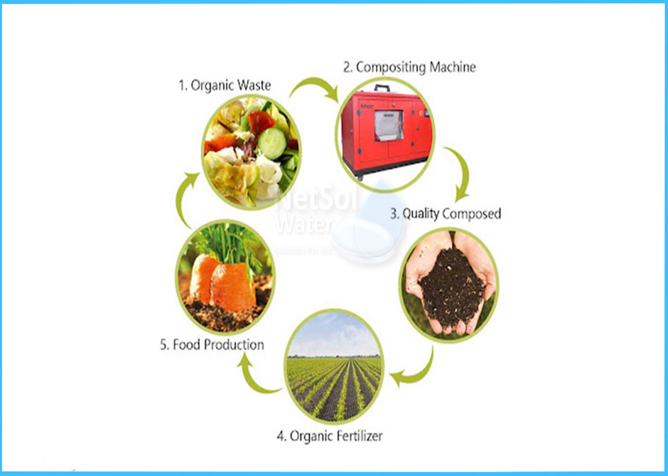
Incremental Provisions
ORGANIC WASTE TREATMENT
A designated area on the project site shall be provided to compost (manually or mechanically) to comply with the requirements as per Table.
Image source: Kolkata Municipal Corporation, Link
Provision | Incremental Points
75% of organic waste generated post-occupancy is composted onsite. | 2
95% of organic waste generated post-occupancy is composted onsite | 3
Notes:
Time : 45 Sec
Slide is self explanatory.

Slide 16
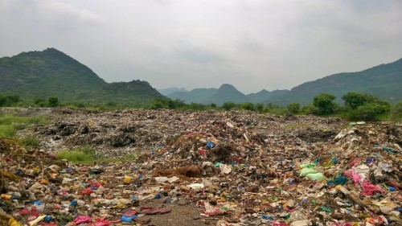
SUMMARY of Waste Management
Construction waste management plan is to minimize the amount of materials going to landfills during construction by diverting the construction waste and land clearing debris from landfill disposal.
Post-occupancy waste management practices can significantly impact the sustainability of a community. Poor waste management practices, such as illegal dumping, can lead to environmental degradation and health risks for residents.
Image source: Globalrec, Link
Notes:
Time : 60 Sec
Slide is self explanatory.

Slide 17
It’s time for a quick knowledge check!
Notes:
Time- 10 Sec

Slide 18
SCAN ME for the quiz!
Notes:
Time- 45 Sec

Slide 19
1. What is the primary goal of waste management?
1) Reduce, Reuse, Recycle
2) Bury all waste in landfills
3) Reuse
4) All of the above
Notes:
Time- 30 Sec
Ans: 3) FOUR

Slide 20
2. Which of the following is not an example of Organic waste?
1) Fruit and vegetable peels
2) Eggshells
3) Aluminum cans
4) Coffee grounds
Notes:
Time- 30 Sec
Ans: 3) 150-200 mm

Slide 21
3. What are the key benefits of using color-coded waste bins?
1) Helps in better waste segregation
2) Increases the volume of waste
3) Reduces contamination of recyclable materials
4) All of the above
Notes:
Time- 30 Sec
Ans: 3) FOUR

Slide 22
4. What is the recommended method for managing organic waste?
1) Composting
2) Burning
3)Dumping in landfills
4) All of the above
Notes:
Time- 30 Sec
Ans: 3) 150-200 mm

Slide 23
5. Why is waste segregation important?
1) To make waste disposal easier
2) To recycle useful materials
3)To reduce landfill waste
4) All of the above
Notes:
Time- 30 Sec
Ans: 3) 150-200 mm

Slide 24
Let’s see how you scored!
Notes:
Time- 10 Sec

Slide 25
Sources to better understanding of waste management topic
Eco-Niwas Samhita (ENS) 2024 (Energy Conservation and Sustainable Building Code - Residential)
SOLID WASTE MANAGEMENT IN INDIAN PERSPECTIVES- https://www.researchgate.net/publication/373737929_SOLID_WASTE_MANAGEMENT_IN_INDIAN_PERSPECTIVES_A_COMPREHENSIVE_REVIEW
Challenges and opportunities associated with waste management in India- https://www.researchgate.net/publication/315541171_Challenges_and_opportunities_associated_with_waste_management_in_India
Scenario of solid waste management in present Indian context - https://nswai.org/docs/Scenario%20of%20solid%20waste%20management%20in%20present%20Indian%20context.pdf
Proper Waste Disposal According to the Properties of Each Material- https://youtu.be/Lfj8SKFlTpI?feature=shared
Waste Management - https://youtu.be/29OFyXJC_uA?feature=shared
National Solid Waste Association of India (NSWAI)-https://www.nswai.org/
Waste management -https://en.wikipedia.org/wiki/Waste_management
Waste Management - https://www.almitrapatel.com/collection.htm

Slide 26
THANK YOU!

